Slide 1
Content design overview

Slide 2
Welcome
This Local Digital content design overview aims to cover the basics of content design.​​
The overview will not make you a content designer.​
But it should help you understand how to apply content design thinking in your work. It will also help you to work with content designers more effectively.​

Slide 3
Who should read this overview?
Anyone with an interest in content design and making their content more user-centred and accessible.
For example, you might be working on a product, website or service and want to understand how to write content that meets the needs of your users. ​
It will also help you work with content designers more effectively.

Slide 4
What will this overview cover?
This overview will cover:​​
what we mean by content
what is content design
understanding your users ​
writing and designing user-centred content
accessible and usable content ​
methods for testing content with users​​
You can also find links to further resources and tips for ​putting content design into practice in your own context.
Tip: if you are viewing this file in Edit mode, use Control (ctrl) + Click to open any links you want to access.

Slide 5
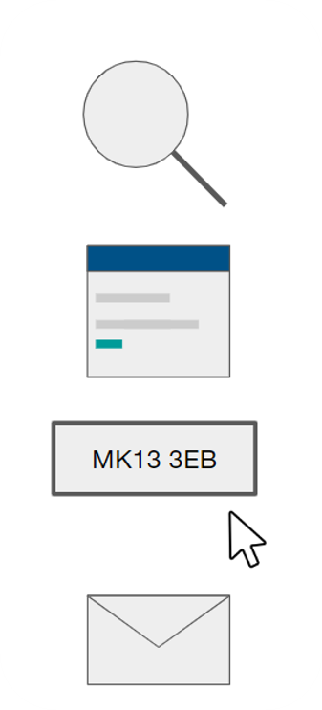
What do we mean by content?
Content is more than just the words you see. ​It's everything you see in a website, product or service.
Users engage with many different types of content. ​
​
For example, if a user needs to pay their council tax, they might:
search for how to pay​
visit a council's website
use the council’s online service
sign-up for weekly email reminders

Slide 6
What is content design?
“Content design is answering a user need in the best possible way for the user to consume it. It helps your user to get that content when they need it, in the language and format they need it.”
Sarah Richards, former Head of Content Design at Government Digital Service (GDS)

Slide 7
What content designers do
Content design starts with a user need. A user is anyone who interacts with one or more of your products and services. ​​
Often, this is an action or task which a user is looking to carry out. ​​
For example, a user might need to:​​
book a school place for their child​​
check when their bin will be collected​​
know how to pay their council tax
Content designers create content that helps the user complete the action or task.

Slide 8
What content designers do not do
Content designers are not responsible for:​
copywriting – a copywriter writes content to communicate a key message, such as encouraging someone to buy or sign-up for something​
PR, comms or marketing – news items, press releases and promotional materials are usually created by communications professionals, not content designers

Slide 9
User-centred content design

Slide 10
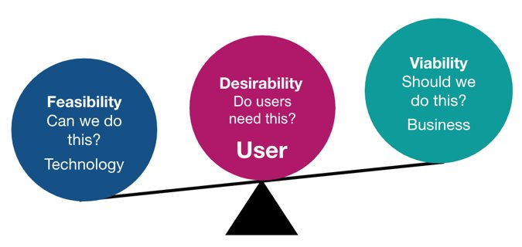
Good design is centred on users
User-centered design is all about putting users and their needs at the centre of every design decision. This foundation is also essential to content design.
User-centred design is about putting users, not technology, at the centre.

Slide 11
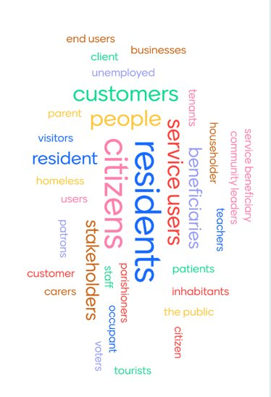
Who is the user in user-centred design?
A user is anyone who interacts with one or more of your products and services. They can be internal or external.​
Find the most appropriate word to use to describe your audience on a project-by-project basis.​
It may be service user, beneficiary or resident. Whatever is most relevant to your project.
Some projects find it useful to create a few 'typical' users to help sense check ideas. Think of some individuals who best represent your target group.

Slide 12
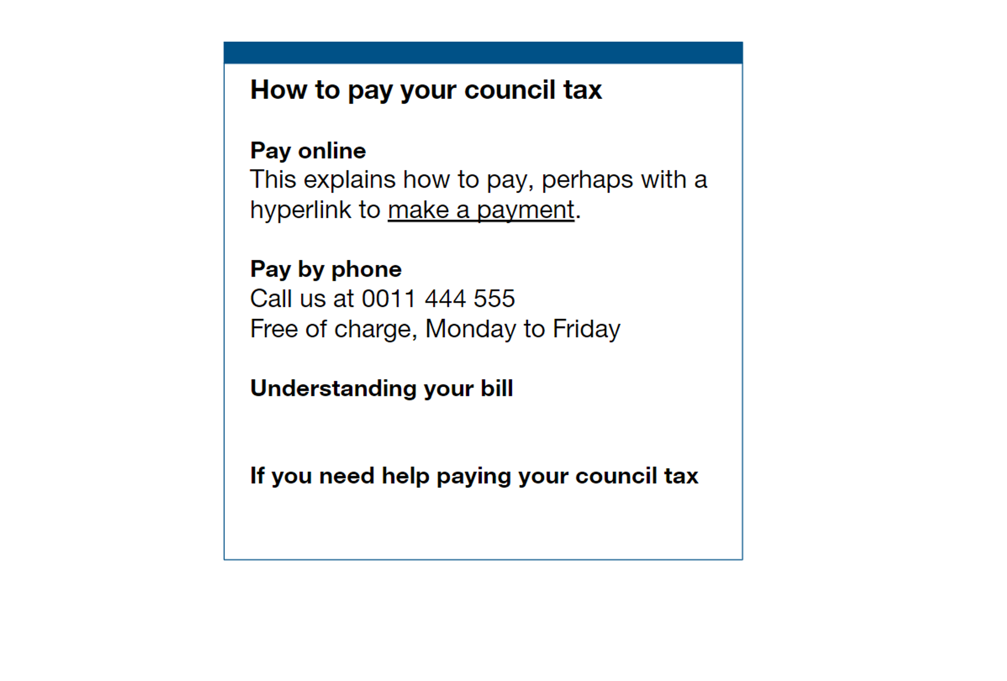
A user-centred webpage
A user-centred webpage should have a clear, descriptive page title.​​
No waffle, just clear headings on what users need to know.​​
Paragraphs should give the information users need, quickly and clearly.

Slide 13
The first step is to identify user needs
A content designer should work closely with a user researcher to identify user needs.​​
They will:​
observe user research and offer to take notes​
work with the researcher to summarise what’s been learned
turn findings into actions to improve content
create a bank of user needs to meet through content

Slide 14
How to meet user needs with content
This is an example of a user need, written as a user story:​​
As a resident​
I need to pay my council tax ​
So that I don’t get a fine​
You might meet this need by creating a webpage on your council’s website where the user can pay their council tax.

Slide 15
If the team does not have a user researcher
A content designer can use other techniques to learn more about users.​​
They will:​​
look at existing user feedback gathered through surveys and focus groups ​​
speak to frontline staff, such as customer services​​
look at existing website data
use search tools, such as Google Trends​​. For example, searching for your council's name will show the kinds of things users are commonly looking for in related searches. This could be things like planning, or housing
document what they’ve learned and revisit this as they learn more

Slide 16
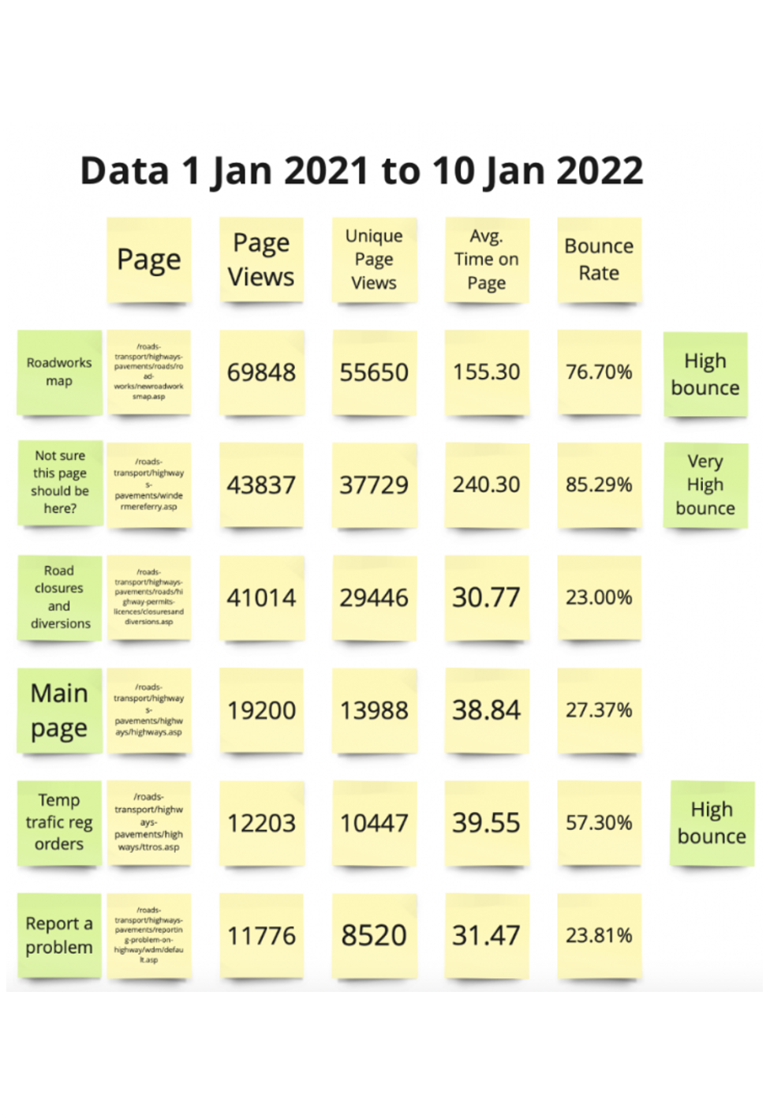
An example of using data in content design
Cumbria County Council used website data to help improve the highways section of the website.
They used Google Analytics data to work out:​​
how popular (or unpopular) the pages were​
which pages people clicked on and then immediately clicked away from (bounce rate)​
which pages people spent longer on​
​Their content designer said: "Using data allowed me to discover the main things people are interested in, where people struggled and where I should focus my attention.”

Slide 17
Good content design starts with planning
Once the user needs are clear, the next step is to plan the content.​​
A content designer will ask questions such as:​​
what content type will best meet this need?​​
how can I convey the information clearly and simply?​
where will users be coming from, such as Google search, or email?​​
who else needs to be involved, to fact-check or sign-off the content?​​
how much information do we need to give to make things clear, but not overload users?

Slide 18
Accessible and usable content

Slide 19
Why content should be easy to understand
Up to 5 million people in the UK have visual disabilities or dexterity difficulties, and 1 in 10 people have dyslexia. ​All these users may face barriers and challenges with content. ​
One of the most important things you can do is to make sure your content is easy to understand.​
For example, do not choose a difficult word when there is a simpler alternative.
Don’t say: We refer you to our dedicated webpage in order to complete your recycling centre reservation.​​
Do say: You can book a tip visit online.

Slide 20
Accessibility and the law
Accessibility regulations came into force for public sector bodies on 23 September 2018. This includes local government organisations.
The regulations say you must make your website or mobile app more accessible by making it perceivable, operable, understandable and robust. These 4 design principles are often referred to as ‘POUR’.
You may not need to fully meet accessibility standards, if this would be too much for your organisation to cope with. This is called a ‘disproportionate burden’. GOV.UK has lots of useful information to help you check if this applies to you. There’s also guidance on how to make sure websites, services and apps are accessible.

Slide 21
Accessibility principles
Here are some examples of how these principles apply to content.
Perceivable – make sure users can recognise content. This includes providing captions for videos and not using colour as the only way to explain something.
Operable – make sure users can find and use content. For example, make sure content works for someone who’s only using a keyboard to navigate.
Understandable – make sure users understand content. For example, write content that is easy to read, and make it simple for users to sign-in to services.
Robust – make sure content can be interpreted by a variety of assistive technologies, such as screen readers.

Slide 22
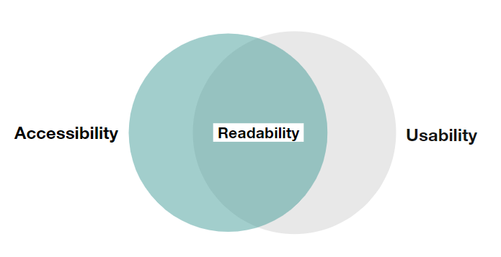
Accessibility and usability
Readability is about how easy or difficult it is to read something.
Good readability improves usability but it also improves accessibility. For example, content that is clear for users reading on a mobile phone can also benefit users with a lower reading age.

Slide 23
How to review content for accessibility
Use in-built tools to help you create accessible content, including documents. You can run the accessibility checker in Microsoft products, such as Word and PowerPoint. Select the review tab, then select ‘check accessibility’. This will give you helpful suggestions to make your content more accessible.
Creating an accessible structure for your content is essential. For example, apply heading styles to help users easily navigate through the content’s hierarchy.
Use heading styles sequentially. Start by giving your content a clear title, then use Heading One, followed by Heading Two, Heading Three and so on.

Slide 24
Learn more about making content accessible
Worcestershire County Council developed SCULPT, a beginner’s guide to help create accessible content, including documents. ​
SCULPT stands for:​​
structure (headings and styles)​
colour and contrast​
use of images​
links (hyperlinks)​
plain English​
table styles

Slide 25
Writing and designing content

Slide 26
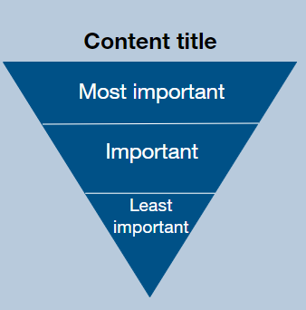
How to structure clear content
Writing for the web is very different from other types of writing, such as reports.​
Well-structured content puts the most important information at the top. Digital content does not need a long introduction. It just gives users what they need.​
Additional information is in order of decreasing importance. ​​
This is called the 'inverted pyramid'.

Slide 27
Making content easy to read
One way to make your content easier to read is by using the active voice.​
An active sentence makes clear who is doing what by putting the subject of the sentence (the person or thing doing something) upfront. A passive sentence sometimes gets rid of the subject altogether.​
Do say: You can hire the swimming pool for children's parties ​
​
Don’t say: The swimming pool can be hired for children's parties​​
Using the active voice makes content more concise. This helps all users. From someone who’s quickly scrolling through content on a mobile phone, to ​someone who speaks English as an additional language.

Slide 28
Writing link text
A content designer will make sure any hyperlinks (or links) are descriptive. Avoid generic links, which don’t help the user understand where they are about to go. Good link text should make sense when read out of context.
Do say: Pay a parking fine online.​
​
Don’t say: To pay a parking fine click here. Screen reader users often navigate from link to link, skimming the content in between by using the 'tab' key. This means they will hear the link read to them, with no visual context about where the link will go. By using descriptive link text, the user can easily toggle between different links when read aloud.

Slide 29
Testing content

Slide 30
Testing content by working with user researchers
Before publishing, it's a good idea to test content with real users.​
Content designers can work with user researchers to arrange usability testing.​​
Usability testing involves asking a user to complete a task, observing them, and asking questions to learn more.
Sometimes tight timescales might mean you are not able to test with real users as early as you might like. If this happens, you can test early drafts of the content with colleagues or others who are not familiar with the product or service.

Slide 31
Usability testing example
In this example scenario, a content designer is working on a digital service for users to check when their next bin collection is.​​
Usability testing could include asking users:
to find out when their next collection is
​how they would usually approach finding this information​
how they found the experience

Slide 32
Other methods for testing content
You could also use these methods to test content:
A/B testing – create 2 different versions of the same content and test which performs better. This could include testing different variants of the page design, or wording on the page.
Highlighter testing – print a copy of the content and ask users to highlight things which are easy to understand in one colour. Then, ask them to use another colour to highlight anything they find confusing.

Slide 33
Next steps

Slide 34
Putting content design into practice
Here are some ideas to start using content design thinking in your day-to-day role:​​
learn more about your users – this could be by working with a user researcher, or by using existing user feedback from different channels​
structure content using the inverted pyramid – put the most important information at the top, followed by points of decreasing importance ​
use concise, plain language – try using the Hemingway editor tool to write using the active voice and make your writing easier to understand
search for case studies – see how other councils improved the readability, usability and accessibility of their content, such as Leeds City Council

Slide 35
Tell us what you thought of this overview
If this overview was useful to you, do share it with your colleagues.​​
​​
Please take a moment to complete our feedback survey (link opens a Microsoft Form). ​​
​​
Thank you. ​ ​

