Slide 1
User research overview

Slide 2
Welcome to an overview of user research
This Local Digital user research overview aims to cover the basics of user research.
The overview will not make you a user researcher.
But it should help you start using user research approaches within your organisation.

Slide 3
Who should read this overview?
Anyone who has an interest in user research or user-centred design.
For example, perhaps you’re working on a product, website or service and want to understand how user research can help.
It will also help you work with user researchers more effectively.

Slide 4
What will this overview cover?
This overview will cover:
what is user research
generative and evaluative research methods
analysis and synthesis
insights and 'how might we' options
You can also find links to further resources and tips for putting user research into practice in your own context.
Tip: if you are viewing this file in Edit mode, use Control (ctrl) + Click to open any links you want to access.

Slide 5
User research is:
"Understanding the people who use your service and their experience doing so is key to redesigning or developing new digital services that meet users’ needs. Effective user engagement is essential to ensure successful design and take-up of new online services."
Local Government Association: User research and testing,
September 2019

Slide 6
What is user research?

Slide 7
What does user research involve?
User research involves gathering information from people first hand to understand behaviours, thoughts, feelings and how they contribute to the set of needs.
We use research to better understand:
who our users are
what they need to do
how they behave in different types of situations
This is so we know we’re solving the right problem when delivering vital services.

Slide 8
How to approach user research
User research is not the same as scientific research. We are not looking to prove the ‘truth’. We just need to learn enough to know what to do next. But that does not mean that we should not be robust. User research needs to take account of:
methodology
sampling
running interviews
synthesis
Later parts of this overview will expand on these aspects that help to make
user research robust.

Slide 9
Who should be involved in user research?
Get the team and any stakeholders involved in conducting and synthesising the research. It promotes empathy, clear communication and helps people understand needs.
Think about which roles the team or different stakeholders can play. Could they be an observer or note-taker? Note-taking is a good way for people interested in learning more about research to learn and get involved. User research is a team sport.

Slide 10
But remember, you are not the user
Neither is:
your boss, or other stakeholder's
the loudest person in the room, or the highest paid person (sometimes referred to as the ‘hippo’)
Everyone should have space to share their voice. Following one voice, idea or opinion creates risk and can allow bias to creep in unchecked.
It can be challenging to champion user research culture when there’s a ‘hippo’ pushing back. Especially if they are more senior than you.
But understanding our users, and being user-led, can help to change this.

Slide 11
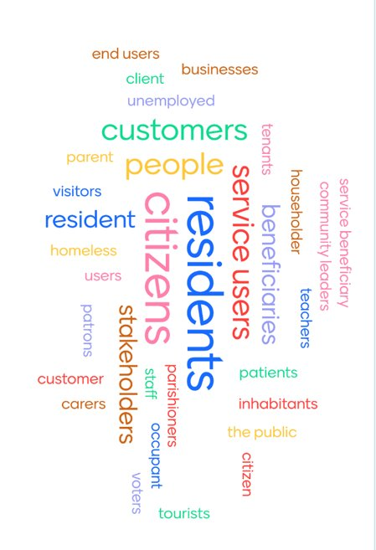
Who is the user in user research?
A user is anyone who interacts with one or more of our products and services. They can be internal or external.
Find the most appropriate word to use to describe your audience on a project-by-project basis.
It may be service user, or beneficiary or resident. Whatever is most relevant to your project.
Some projects find it useful to create a few 'typical' users to help sense check ideas. Think of some individuals who best represent your target group.

Slide 12
What are user needs?
User needs are the needs that a user has of a service, and which that service must satisfy for the user to get the right outcome for them. Services designed around users and their needs:
are more likely to be used
help more people get the right outcome for them
cost less to operate by reducing time and money spent on resolving problems

Slide 13
User need example
User needs can be framed in this format: As a = which type of user has this need?
I need to = what does the user need to do?
So that = why does the user want to do this?
This is an example of a user need:
As a local resident
I need to understand the local government waste disposal system
So that I can understand what rubbish I can take to the tip

Slide 14
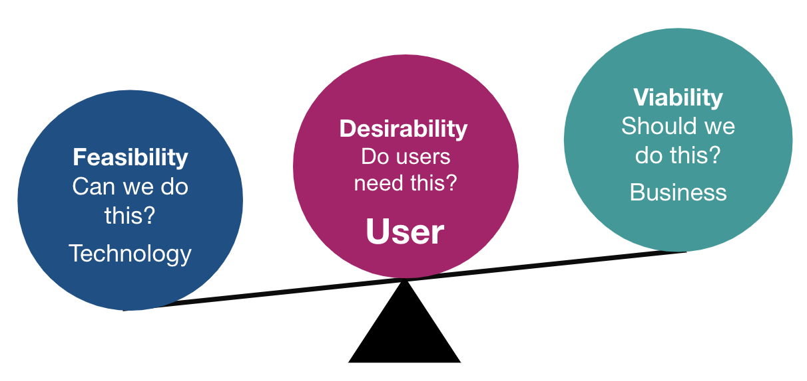
User research is part of user-centred design
User-centred design is all about putting users and their needs at the centre of every design decision.
This foundation is also essential to user research.
User-centred design is about putting users, not technology, at the centre.

Slide 15
User research is not just good for users
Although research is focussed on users, this does not mean it is at odds with the organisation’s business needs.
In fact, there is a sweet spot within the overlap that:
is good for the user
is good for the business
lowers risk
can reduce subsequent queries to support lines
can increase productivity
can help internal local government teams in their day-to-day work

Slide 16
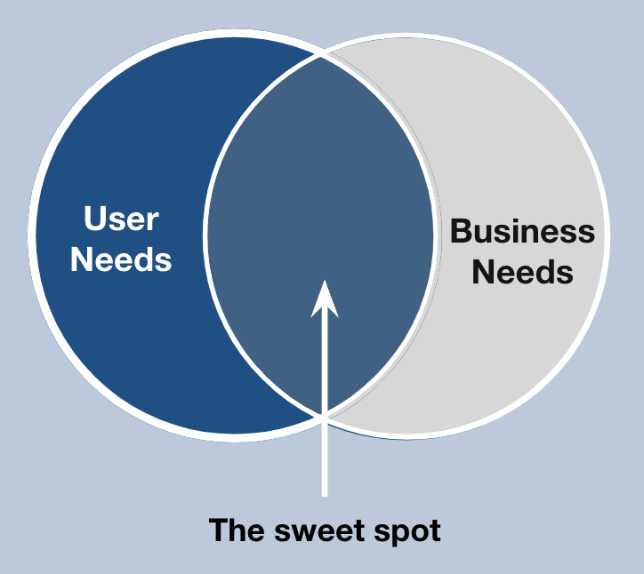
User research is good for business
Development is expensive.
Delivering a service is expensive.
Delivering the wrong service is even more expensive.
You can potentially waste time and valuable resources if you do not understand the user and business needs and how they need to balance.

Slide 17
User research example
HMRC used user research to simplify their tax services. HMRC introduced a new feature on their app that allows users to pay self-assessment taxes through everyday digital banking. Putting users at the centre of the design played a critical role in the success of their solution.
It involved:
engaging with users to discover and address their core needs
reducing the risk of making mistakes when paying their tax bill
instilling trust that their payment is going to the right place
using data shared by commercial banking apps to identify online banking as the best channel to meet user needs (76% preference in the UK)

Slide 18
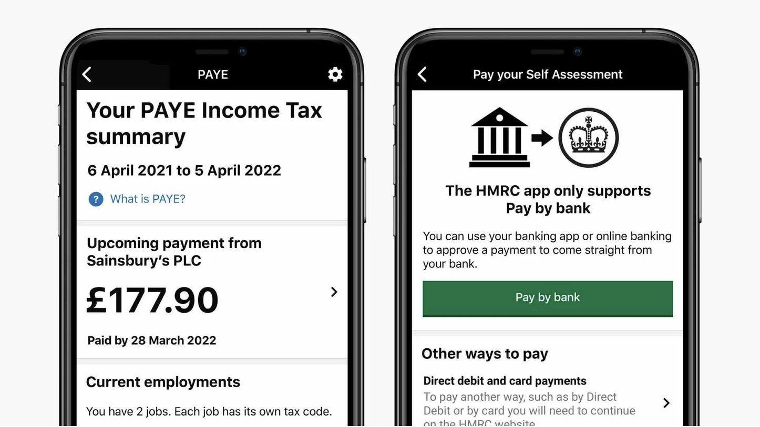
Successful outcomes from putting users first
As a result of this approach:
HMRC reduced the risk associated with launching a new feature by understanding user needs and behaviours early in the design process
HMRC created a trusted digital service downloaded by 3 million users since 2016
over half a million users access the app monthly

Slide 19
What researchers rarely do
User researchers rarely do:
market research, which focuses on purchasing behaviours, brand and messaging preferences
social research into behaviour and trends based on policy and law – these are usually addressed by the key stakeholder or product owner
User researchers never only tell you what you want to hear!

Slide 20
Generative and evaluative research

Slide 21
What is generative research?
User researchers use a combination of generative and evaluative research methods. Generative research helps researchers develop a deeper understanding of users to find opportunities for solutions and innovation. Sometimes referred to as discovery or exploratory research, the goal is always the same. To identify new and innovative solutions, you must understand the problem you are trying to solve. This requires you to truly understand how people live, including their environments, behaviours, attitudes, opinions and perceptions. Some examples of generative research include desk research, interviews, focus groups, workshops, diary studies and contextual inquiry.

Slide 22
What is evaluative research?
Evaluative research is used for assessing a specific problem to ensure usability and ground it in the wants, needs and desires of real people.
The goal of evaluative research is to test your existing solution (or ideas for a solution) to see if it meets people’s needs and is easy to access and use.
This type of research should be conducted throughout the development lifecycle, from early concept design (think rough sketches or prototypes) to the final site, product or service. Some examples of evaluative methods include usability testing, card sorting, tree
testing, concept testing, A/B testing, analytics and usability benchmarking.

Slide 23
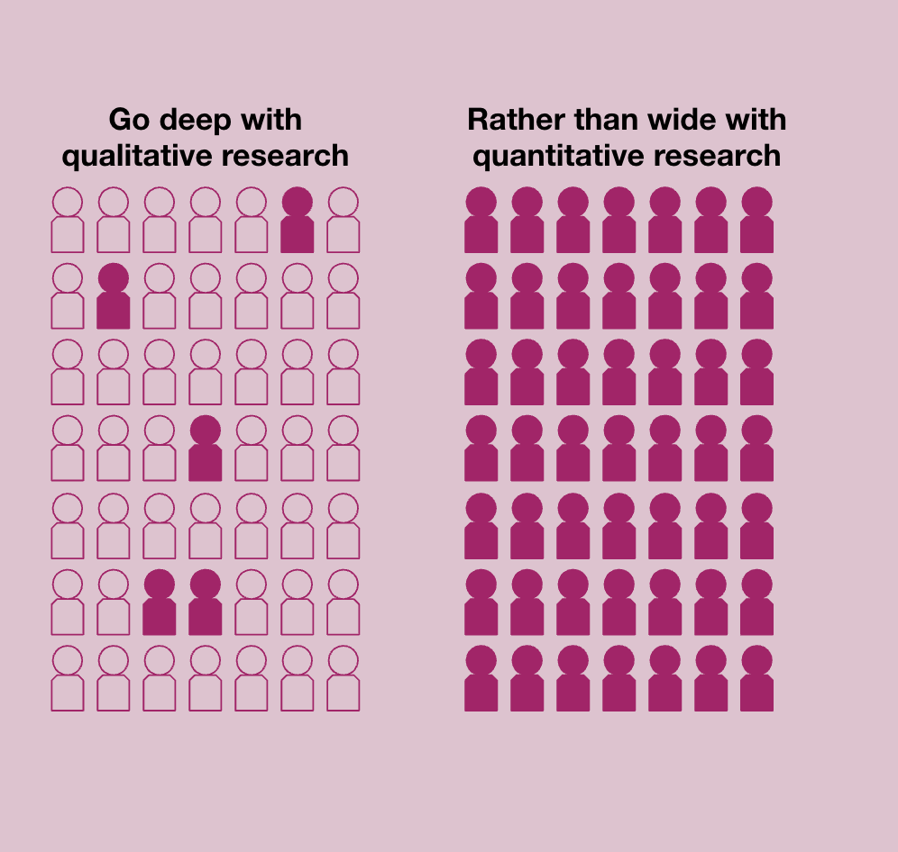
Qualitative and quantitative research
The main focus in user research is qualitative research, or anything that involves getting first-hand information. Mixing methods with quantitative, numerical or measurable data, like surveys, rating scale surveys and data adds depth and breadth.
Be aware of sampling bias, where some members of a population are systematically more likely to be selected in a sample than others.

Slide 24
Good research starts with a good plan
A good research plan:
holds all your questions, planning and activities for your research
clarifies what is known, what is unknown and what you’re unsure about
contains any ethical considerations for your research
becomes the key reference point for your research
Ethical user research should consider:
transparency and informed consent
privacy, confidentiality and data protection
the wellbeing and dignity of anyone involved
being neutral and being aware of bias
honest and accurate interpretation of results

Slide 25
What goes into a research plan
Research objectives – what do you want to achieve with your research? What are your key questions about your project?
Key users – who is affected by the problem you want to solve? Who would be affected by your ideas for solutions? Research activities – what can you do to test your ideas and assumptions? Who do you need to talk to? Ethical considerations – what do you know about the needs of the people you want to involve in your research? How might they respond to your research project?

Slide 26
Generative research methods

Slide 27
User interviews
Generative research is all about developing a deeper understanding of your users and defining the problem. User research interviews are a generative method where you meet with participants, usually one to one, to interview them about the topic in question. Interviews allow you to gather a lot of information about user needs through discussion. They are an essential tool throughout the design process.
To conduct an interview, you need clear objectives, a discussion guide, note-taking document and a plan for analysis.
The facilitator, note-taker, and sometimes observer from the wider team would ideally feed into analysis, with the user researcher leading.

Slide 28
Note-taking role for interviews
Tips for note-taking during user research interviews:
write verbatim notes to help avoid bias
use headers to divide up your notes
when you hear something you think is important, highlight it in your notes
record with the participant's permission, so that if you don’t catch it all, you can find the actual quote in the audio later
mark notes with a timestamp so you can revisit
make sure to observe body language
make it clear where a note is your idea or comment, for example, add your initials and “we should highlight this story in the presentation”
if you think of a question while you are listening to the interview, but it’s not the appropriate time to ask, write it down to ask later

Slide 29
Workshops
Similar to focus groups, workshops are a group discussion. They are usually run by one of the project team as a facilitator who will follow an agreed script. The main difference between focus groups and workshops is that workshops are usually focused on an activity. This can include things like giving feedback on a prototype.
Observing workshops on their own can also be a great research method to understand what questions are being asked and observe how participants behave.

Slide 30
Evaluative research methods

Slide 31
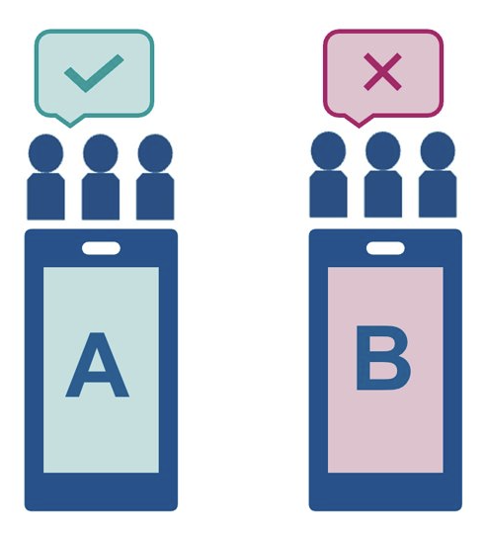
A/B testing
Evaluative user research helps you assess if a solution is on the right track. One approach is A/B testing, which is a method of testing 2 different designs. This can be as a sample screen or a live site. For a live site, this is carried out by randomly assigning groups of users to interact with each of the different designs and measuring the effect of these versions on user behaviour.
A benefit of using A/B testing on a live website or app is there will be a larger set of users and so more quantitative feedback.

Slide 32
Usability testing
Usability testing is where you watch participants try to complete specific tasks using your product or service. You ask them to ‘think aloud’ as they move through the task. As the participant performs these tasks, the facilitator observes the participant’s behaviour and listens for feedback. The facilitator may also ask follow-up questions to draw out detail from the participant. Testing can be moderated, where the participant can ask for help, or unmoderated, where they complete a task independently using software. This type of testing can be used whenever you have a 'thing' you want to test, such as concepts, wireframes, parts of a user journey or a live product.
You might have specific design decisions you want to test, or more general usability.

Slide 33
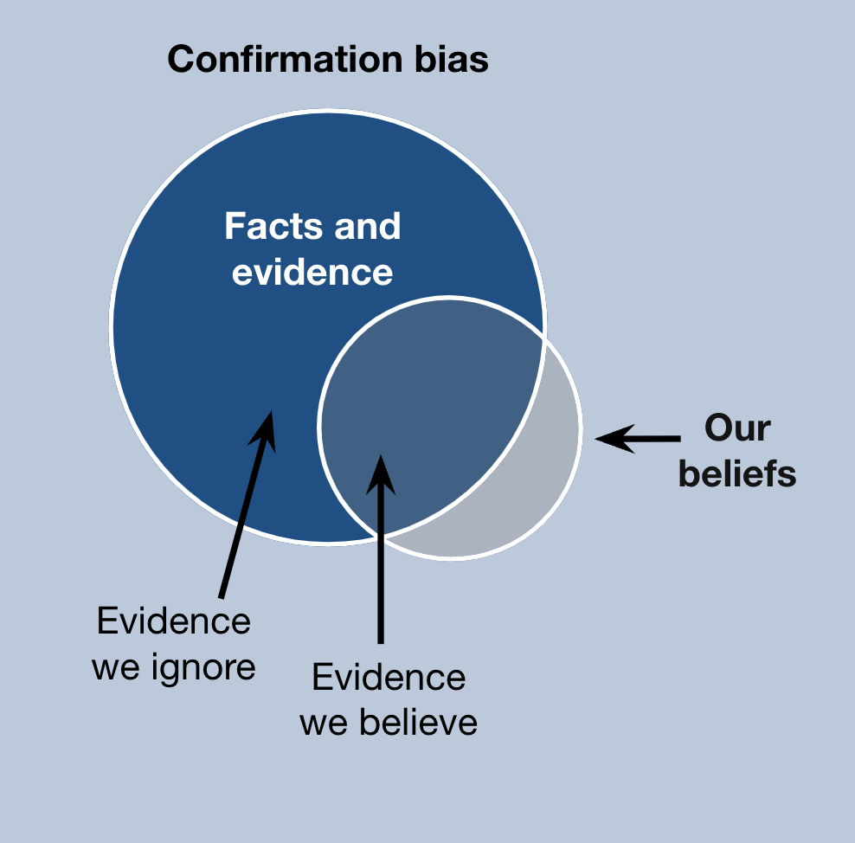
Beware of your bias
With all user research techniques, it is important to be aware of your unconscious bias. Unconscious biases are social stereotypes about certain groups of people that individuals form outside their own conscious awareness. There are a lot of biases that can affect user research. These include confirmation bias, framing effect, anchoring bias and clustering illusion.

Slide 34
Confirmation bias
Confirmation bias is one of the most common biases in user research, and it is important to be aware of this. Confirmation bias refers to our tendency to look for evidence that backs up our initial opinion of someone or something, while overlooking information that contradicts our view.
Ask yourself:
why did the user take that action?
was it because they did not have other options?
is there a possibility they might just be wanting to please you?

Slide 35
Analysis

Slide 36
What is analysis?
User research will create a lot of raw data. You need to need to review this qualitative and quantitative research and extract useful insights. This is called analysis in the user research process. You may need to label the data as you read through the research. This will help you categorise items and find a source-item if the analysis is later queried. You could do this through:
writing interview quotes onto sticky notes to be affinity-mapped (affinity mapping is grouping ideas based on similarities – we will cover this in the next section)
entering observations into a spreadsheet from a usability test

Slide 37
How to approach analysis
Get all your research data into one place. Research comes in all different formats including clips you have listened to, or articles you have read. Read all the data from beginning to end – what starts to look interesting? Code the research based on what it is about. For example, 'housing' or 'trust’. Create codes for emerging themes. Take a break – it's important to come back with fresh eyes. Evaluate your themes for a good fit – if not, you may need to re-group
into themes that are a better fit, with new theme-codes.

Slide 38
Some advice for conducting analysis
When conducting analysis, you should:
give yourself plenty of time
try not to do research analysis on your own – if somebody else observes the session, try to involve them in the research analysis. If not, do discuss your conclusions before your final report
be prepared for research analysis to feel messy – you may not start out with a lot of clarity, but trust that this will come through the conversations you will have with participants
focus on identifying how the user research has clarified the user need – avoid identifying solutions to the user need
As with all parts of user research, be aware of your unconscious biases.

Slide 39
Synthesis

Slide 40
What is synthesis?
During synthesis we start to look for patterns, connections and relationships between data gathered through research and grouped in analysis. The data no longer sits as individual observations. Now we start to form an understanding of our users, their context and their needs. This helps to develop new knowledge taken from our analysis.
Synthesis includes things like:
taking the notes created in analysis and affinity-mapping them
looking at the data created from the interview scripts and identifying user patterns and trends
taking these themes and creating higher level insights

Slide 41
How we approach synthesis
Synthesis is difficult if you have not organised your data when doing analysis. Make sure you can trace it back to the source, such as the interview or piece of desk research it came from. Colour coding and labelling in analysis is now a great help. Refer back to your objectives and why you did this research in the first place.
Explore the data, looking for relevant themes, patterns and stories. Think about:
what information have we learned?
what patterns are we seeing?
what does this all mean?

Slide 42
Affinity mapping
Affinity mapping is a method to group ideas based on similarities. You can do this by placing all your coded data on an online whiteboard like Mural, or sticking notes on a wall. You may notice that your observations will start to group into themes quite naturally. Start by looking for overlaps or duplicates. Make sure your themes are balanced enough so not everything falls under a theme, or the opposite, where just one user quote supports or makes up that theme.
Be aware of your bias. An example of a bias to avoid in analysis and synthesis is clustering bias. We tend to find patterns among randomness when there may be none. This is why having a diverse team with an equal voice to call this
out is important.

Slide 43
Insights and 'how might we's'

Slide 44
Interpreting findings into insights
After interpreting the data, you need to draw out insights. An insight is a short statement that gives us enough shared understanding to take an action.
Insights can reflect a synthesis of many research findings, like quotes or observations. The insights take individual stories into overarching truths. Insights are not observations, but they develop from them.
An observation would be: Residents in the community rely on housing information from their friends and neighbours, though they know this is limited.
The insight could be: Residents prefer to rely on information that they know is limited, rather than find an official source.

Slide 45
Prioritise insights and identify gaps
Consider prioritising and refining your insights. You’ll probably have developed a long list but are they all equally impactful? Could any be merged?
You may wish to agree evaluation criteria upfront. Identify anything which may be critical to know in the future.
It's impossible for research to identify everything. Having gaps in your knowledge is normal.
You may need to do further research or build this into future testing. For example, this may impact who you speak to at the next stage.

Slide 46
Defining the design challenge
When ready, the insights should be developed into a potential action for the team. One method is the 'how might we' statement.
The 'how might we' is shaped as a question and based on high-potential insights. It provides a framework for ideation (coming up with ideas) and the possibility to create new solutions. It should be able to generate several possible solutions. If you can’t think of many ideas, you might need to rework it. A 'how might we' is a goal plus a constraint.
An example 'how might we' for our previous insight could be:
Goal: enhance the visibility of trust-building and knowledge sharing activities.
Constraint: for local residents who do not access official sources of
Information.

Slide 47
User research: useful tools and resources

Slide 48
User research tools
Here are some examples of useful tools for user research.
Whiteboard tools:
Mural, Google Jamboard, Microsoft Whiteboard and Miro
Mural and Miro also have libraries of user research templates. Microsoft has built-in transcript functionality, and you can record interviews with permission.

Slide 49
User research glossary
You can also use the following glossaries to look up words or phrases you might be unfamiliar with.
User research glossaries:
Neilson Norman UX research methods glossary
A complete UX glossary: 101 UX terms UX Design Institute

Slide 50
Next steps

Slide 51
Putting user research into practice
Here are some ideas to start thinking about user research and approaching it in your day-to-day role:
discuss the approaches with others in your team – this could be during a team meeting or a lunch-and-learn session
try thinking about how you could implement some aspects of user research in your role – if you have access to a user researcher, ask them for advice
talk to other colleagues about their experiences of using user research or working with the user researcher in your organisation – this could be colleagues in other councils or organisations you work closely with

Slide 52
Tell us what you thought of this overview
If this overview was useful to you, do share it with your colleagues.​​
​​
Please take a moment to complete our feedback survey (link opens a Microsoft Form). ​​
​​
Thank you. ​ ​

