Slide 1
Agile ways of working overview

Slide 2
Welcome to an overview of Agile
This Local Digital Agile overview aims to cover the basics of Agile ways of working.
It will not make you an expert in Agile. ​​
But it should help you start using Agile approaches in your organisation.​

Slide 3
Who should read this overview?
Anyone with an interest in Agile and user-centered project management.
​
For example, perhaps you’ve recently started a new digital project and want to learn more.​
​
Or perhaps you’ve recently joined a new team that is working in an Agile way.
​

Slide 4
What will this overview cover?
This overview will cover:​​
what digital actually means​
the Waterfall approach, a traditional project management method
the Agile approach​
Agile methods, including Scrum and Kanban​
​
You can also find links to further resources and tips for putting Agile into practice in your own context.
Tip: if you are viewing this file in Edit mode, use Control (ctrl) + Click to open any links you want to access.

Slide 5
Waterfall approach

Slide 6
What is the Waterfall approach?
Traditionally, project management has taken a Waterfall approach. A Waterfall approach follows sequential project steps planned from the start, based on a pre-set specification of what the product is to deliver.
This approach works well for projects where the requirements and user need are static – for example, building a bridge. However, in a world of rapid technology change it can lead to projects being delivered that no longer meet requirements.
For example, the National Plan for IT took so long in delivery that some of the technology it was based on had become obsolete. The Prince2 approach to project management is an example of a Waterfall approach.

Slide 7
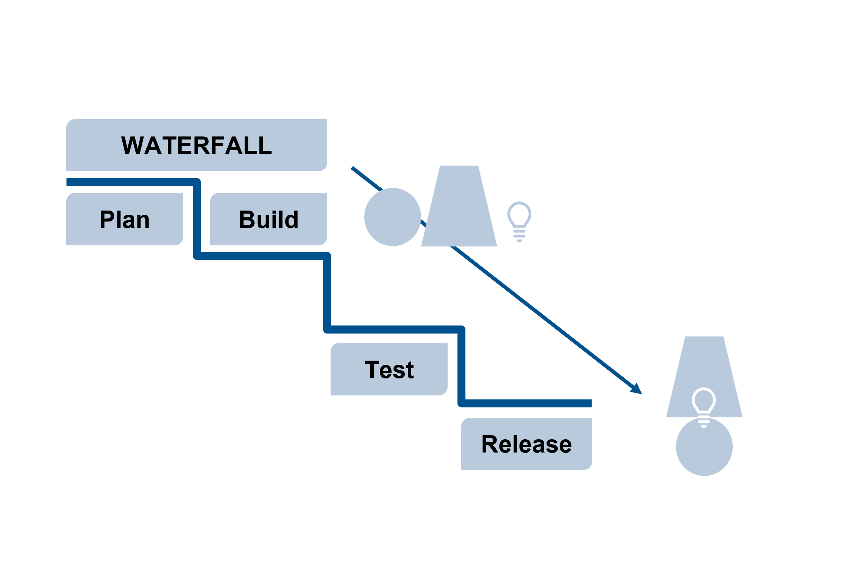
The Waterfall approach
A Waterfall approach has a series of stages before a product is released – planning, building, and testing.

Slide 8
Pros and cons of using Waterfall
The pros for using Waterfall:
uses a clear structure
determines the end goal early on
allows for budget predictability
transfers information well
The cons for using Waterfall:
makes change difficult
longer delivery time for a usable interim product
risk that it is not what is needed
delays testing with end users until completion
Notes:
Waterfall does have advantages but is not an ideal model to use for complex and high-risk projects, which are common in the digital space.

Slide 9
The Agile approach

Slide 10
What is the Agile approach?
Agile is: ​
​an approach that originated in software development in 2001
a flexible approach (rather than adhering to a rigid preconceived idea of a product)
now applied beyond just software development to a range of business contexts
It can be summarised as “finding better ways of developing products and services by doing it with a flexible approach and helping others do it.”

Slide 11
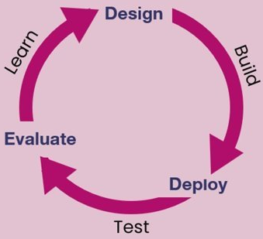
Agile: the ‘test and iterate’ approach ​
Agile working practices can help you to:
build teams and relationships quickly
deliver redesigned services and solutions that better meet user needs through engaging users, repeated testing and iteration from user feedback
design solutions that are more likely to work for the user
Source: LGA “Benefits of an agile approach” (Digital Channel Shift Programme)

Slide 12
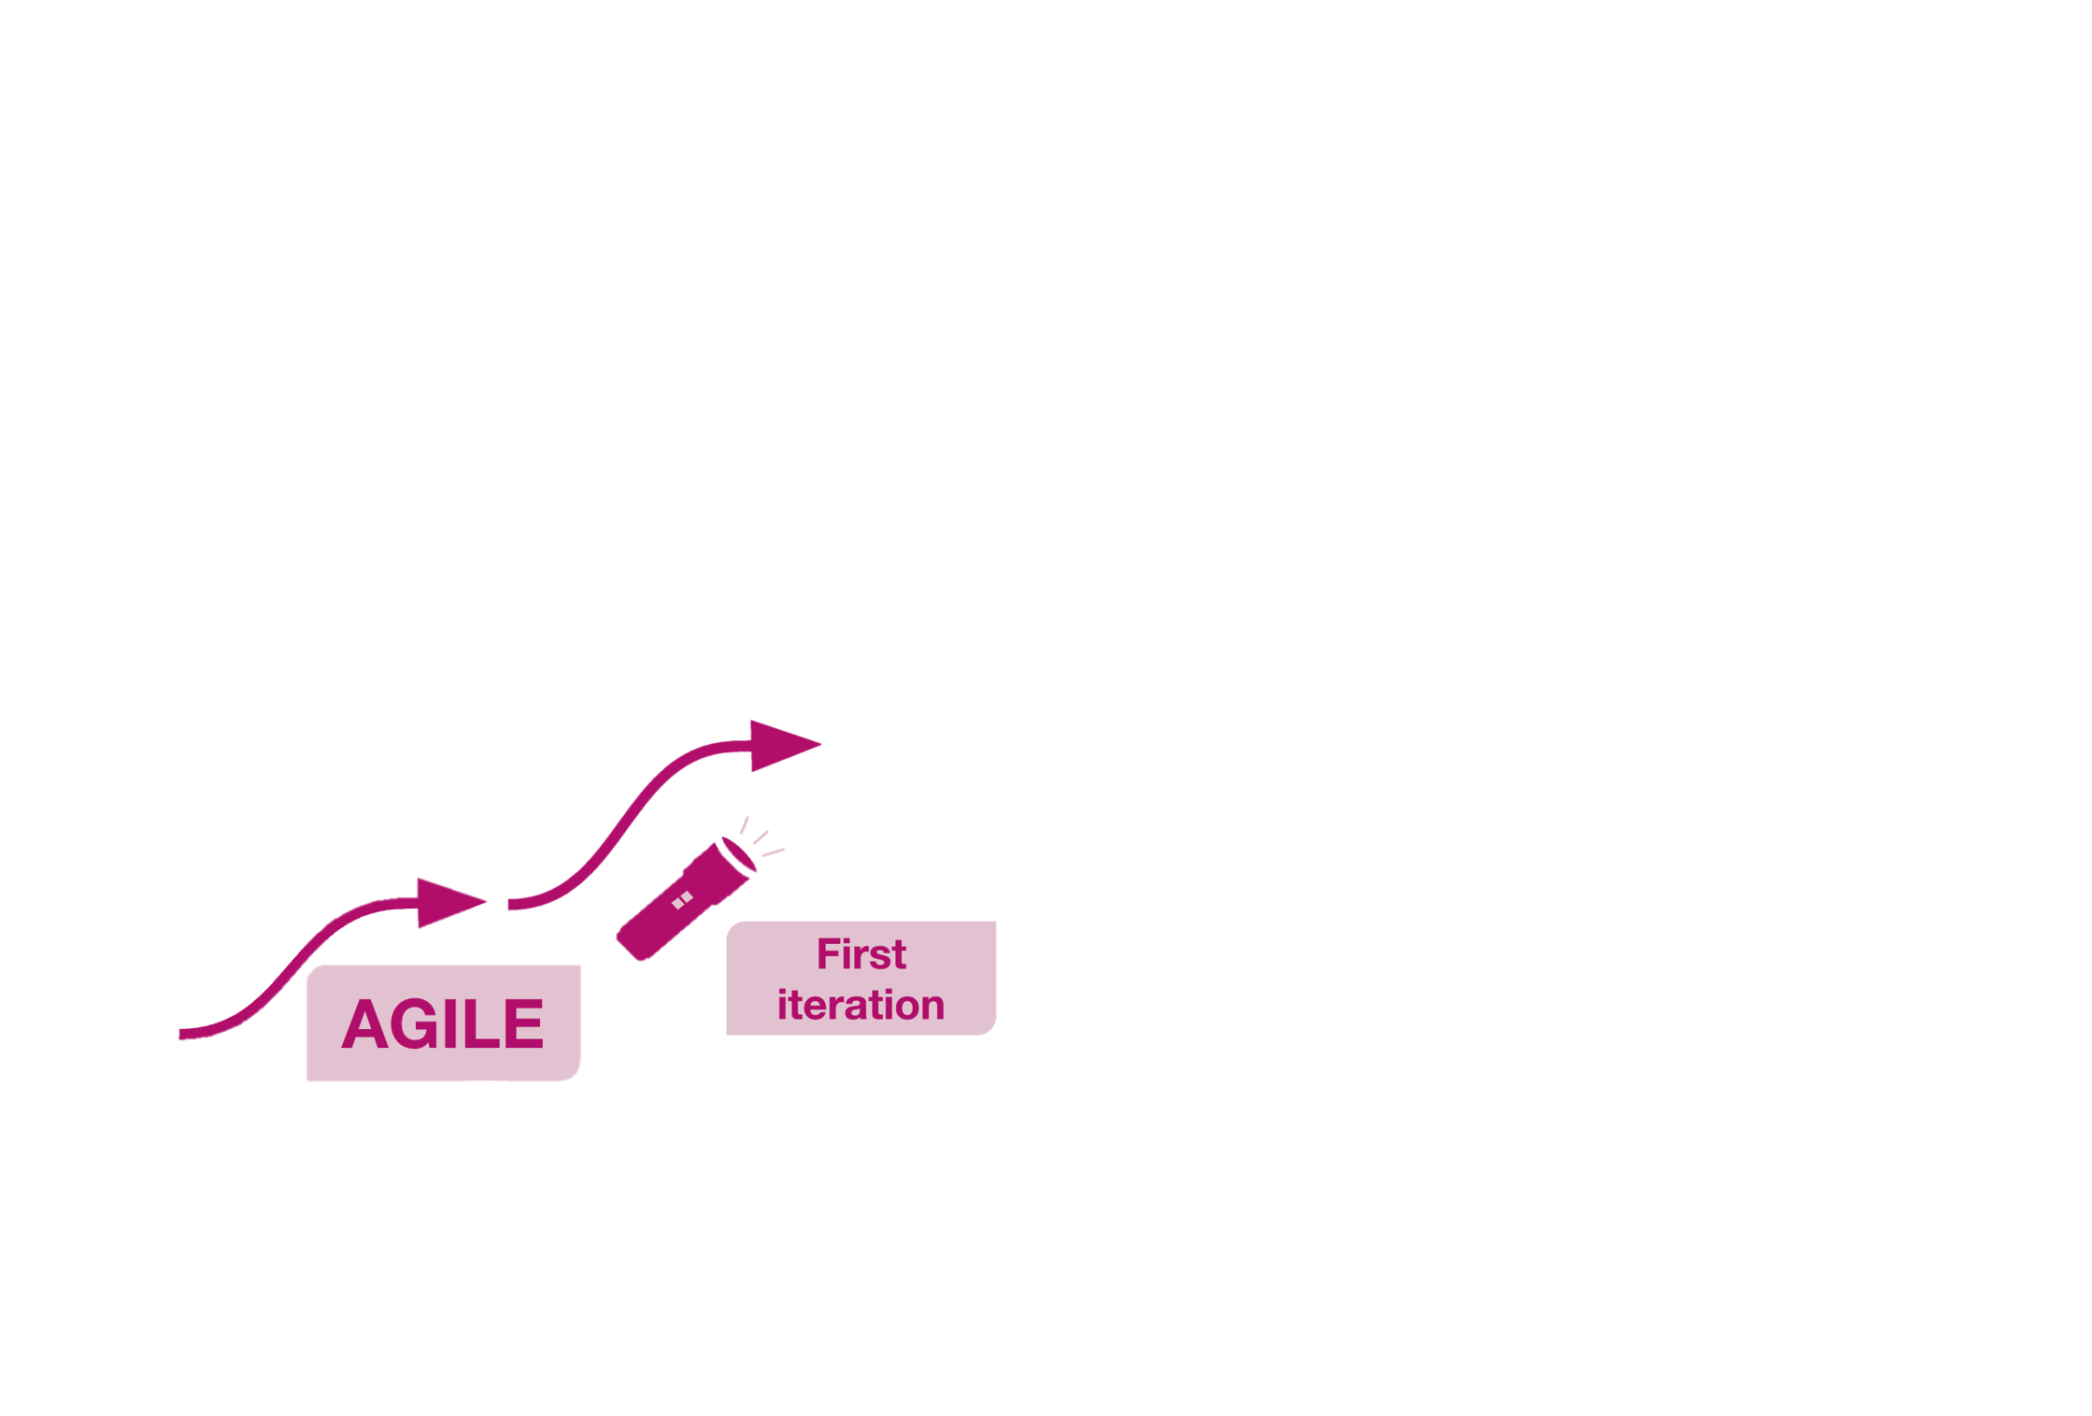
Agile: first iteration
An Agile approach focuses on creating usable versions of a product at each stage, then doing user research and iterating.

Slide 13
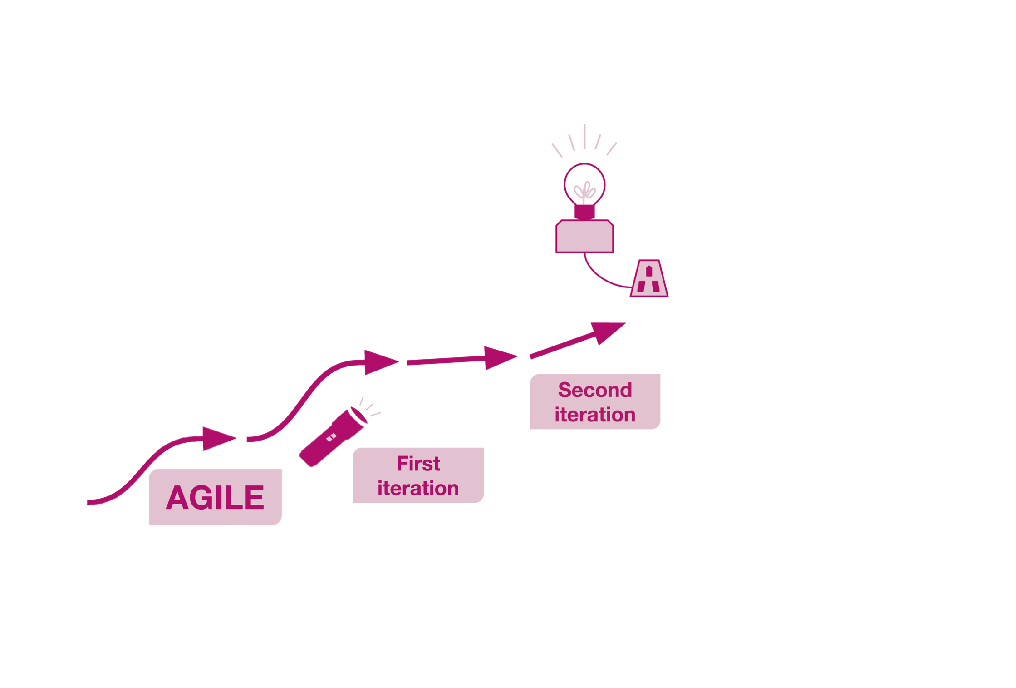
Agile: second iteration
For example, you iterate from a torch, to a test of a mains powered light...

Slide 14
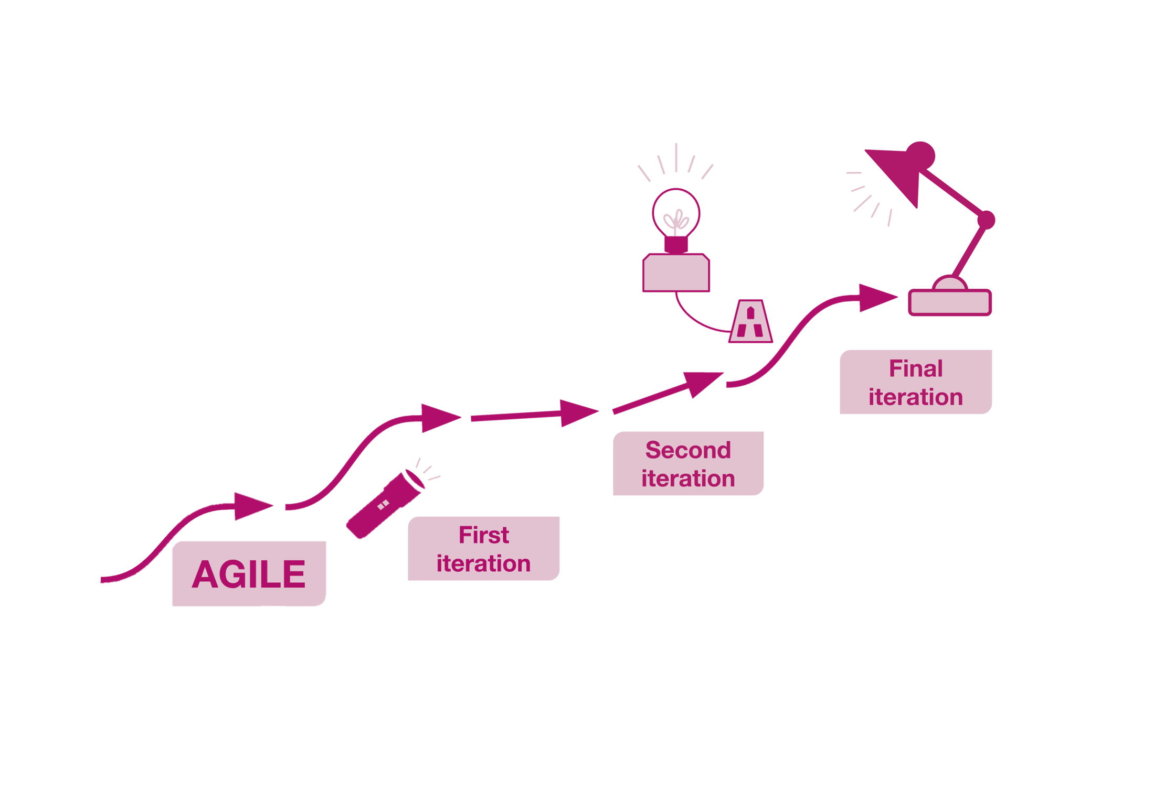
Agile: final iteration
…ending with an adjustable lamp.

Slide 15
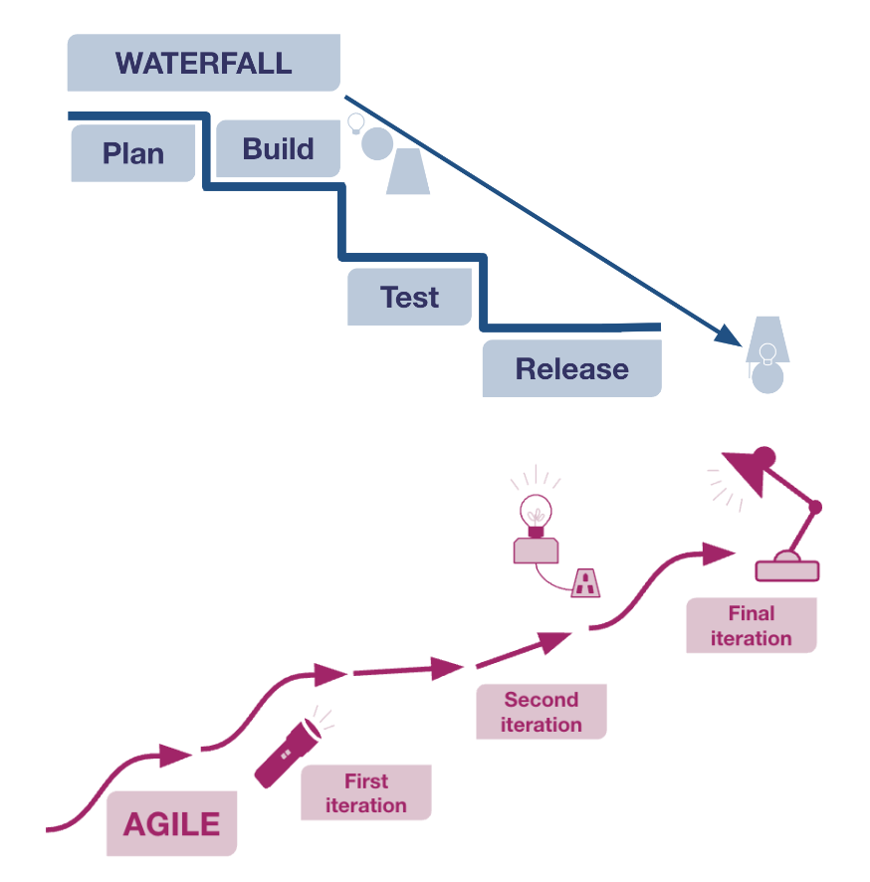
Agile and Waterfall compared
Waterfall uses linear ​
rigid phases. They​
must all be completed before there is a usable product.​
Agile uses several short iterative cycles of a useable product to test and learn.

Slide 16
Key benefits of an Agile approach
The key benefits of an Agile approach include:
frequent releases of usable versions of a product, long before it could be produced using a Waterfall approach
splitting steps into batches helps to speed up iteration
user research at appropriate points provides scope to adjust the product, and ensure it continues to meet the needs of users

Slide 17
The Scrum method

Slide 18
The Scrum method
Scrum:
is the most commonly used Agile method
offers a highly structured model with clearly defined roles and responsibilities
can be particularly useful for traditionally structured organisations that are moving to Agile

Slide 19
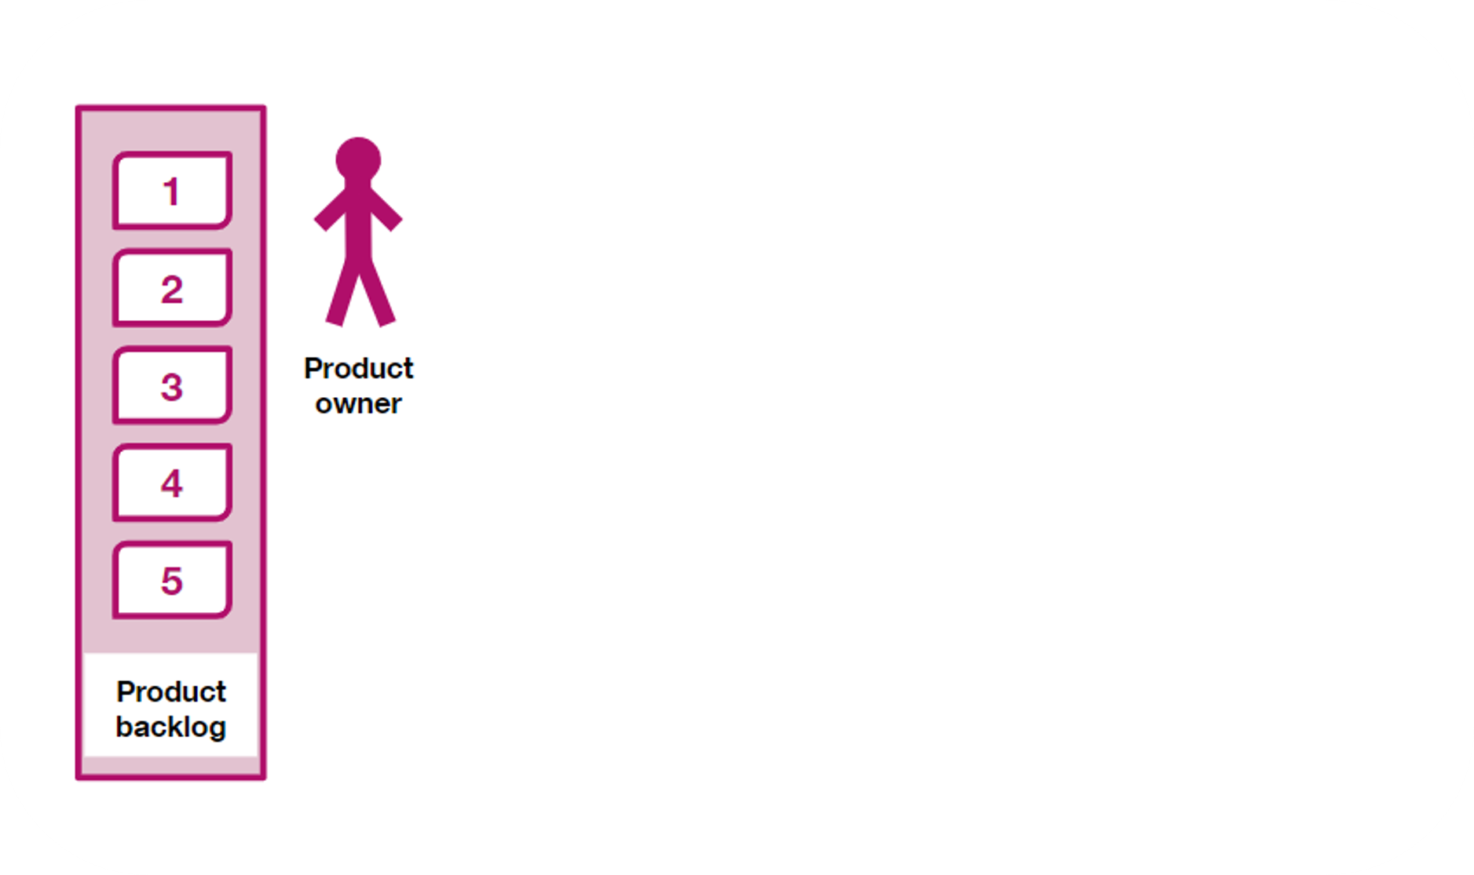
The Scrum method: product backlog
In an initial discovery phase, specific members of the team identify a set of user needs.
These are collated to create the product backlog.
The product owner prioritises the items in the product backlog.
The product owner on a Scrum team is responsible for the project's outcome.

Slide 20
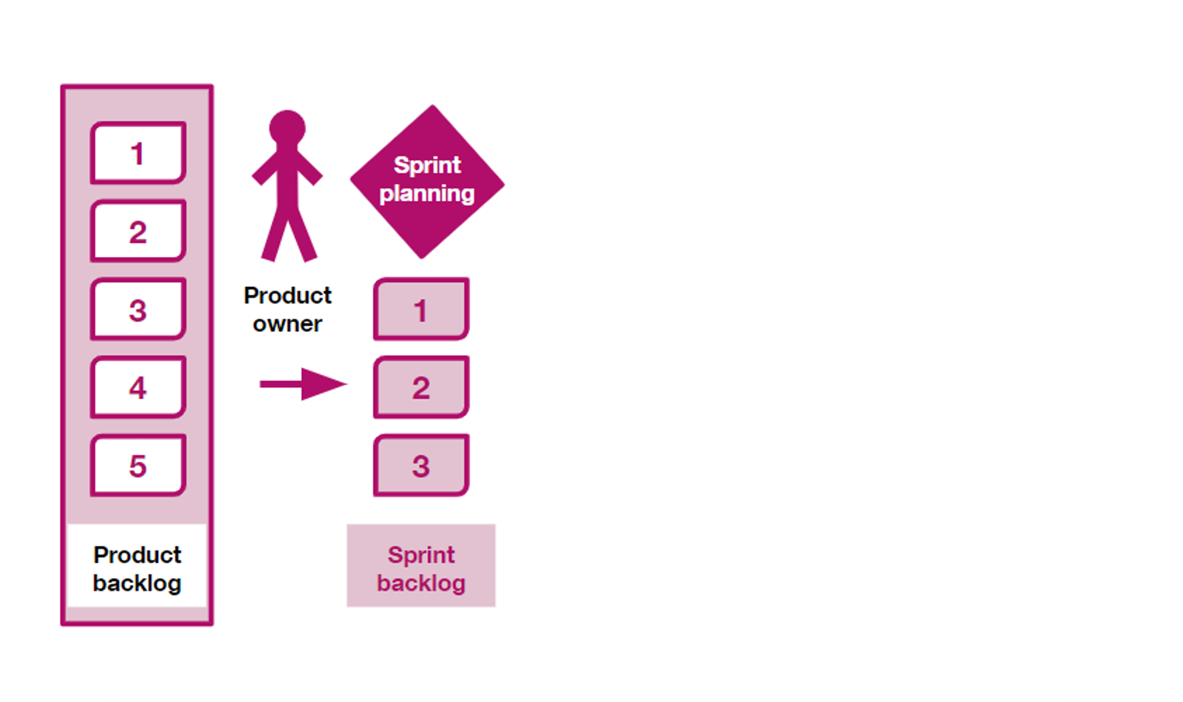
The Scrum method: sprints
The Scrum method uses short stages called sprints. Sprints are usually 2 weeks long.​
​
During planning meetings at the start of each sprint ('sprint planning'), the team ​agree on which items will be ​completed in the sprint.​
​
This is the sprint backlog, ​the list of all things to be done.

Slide 21
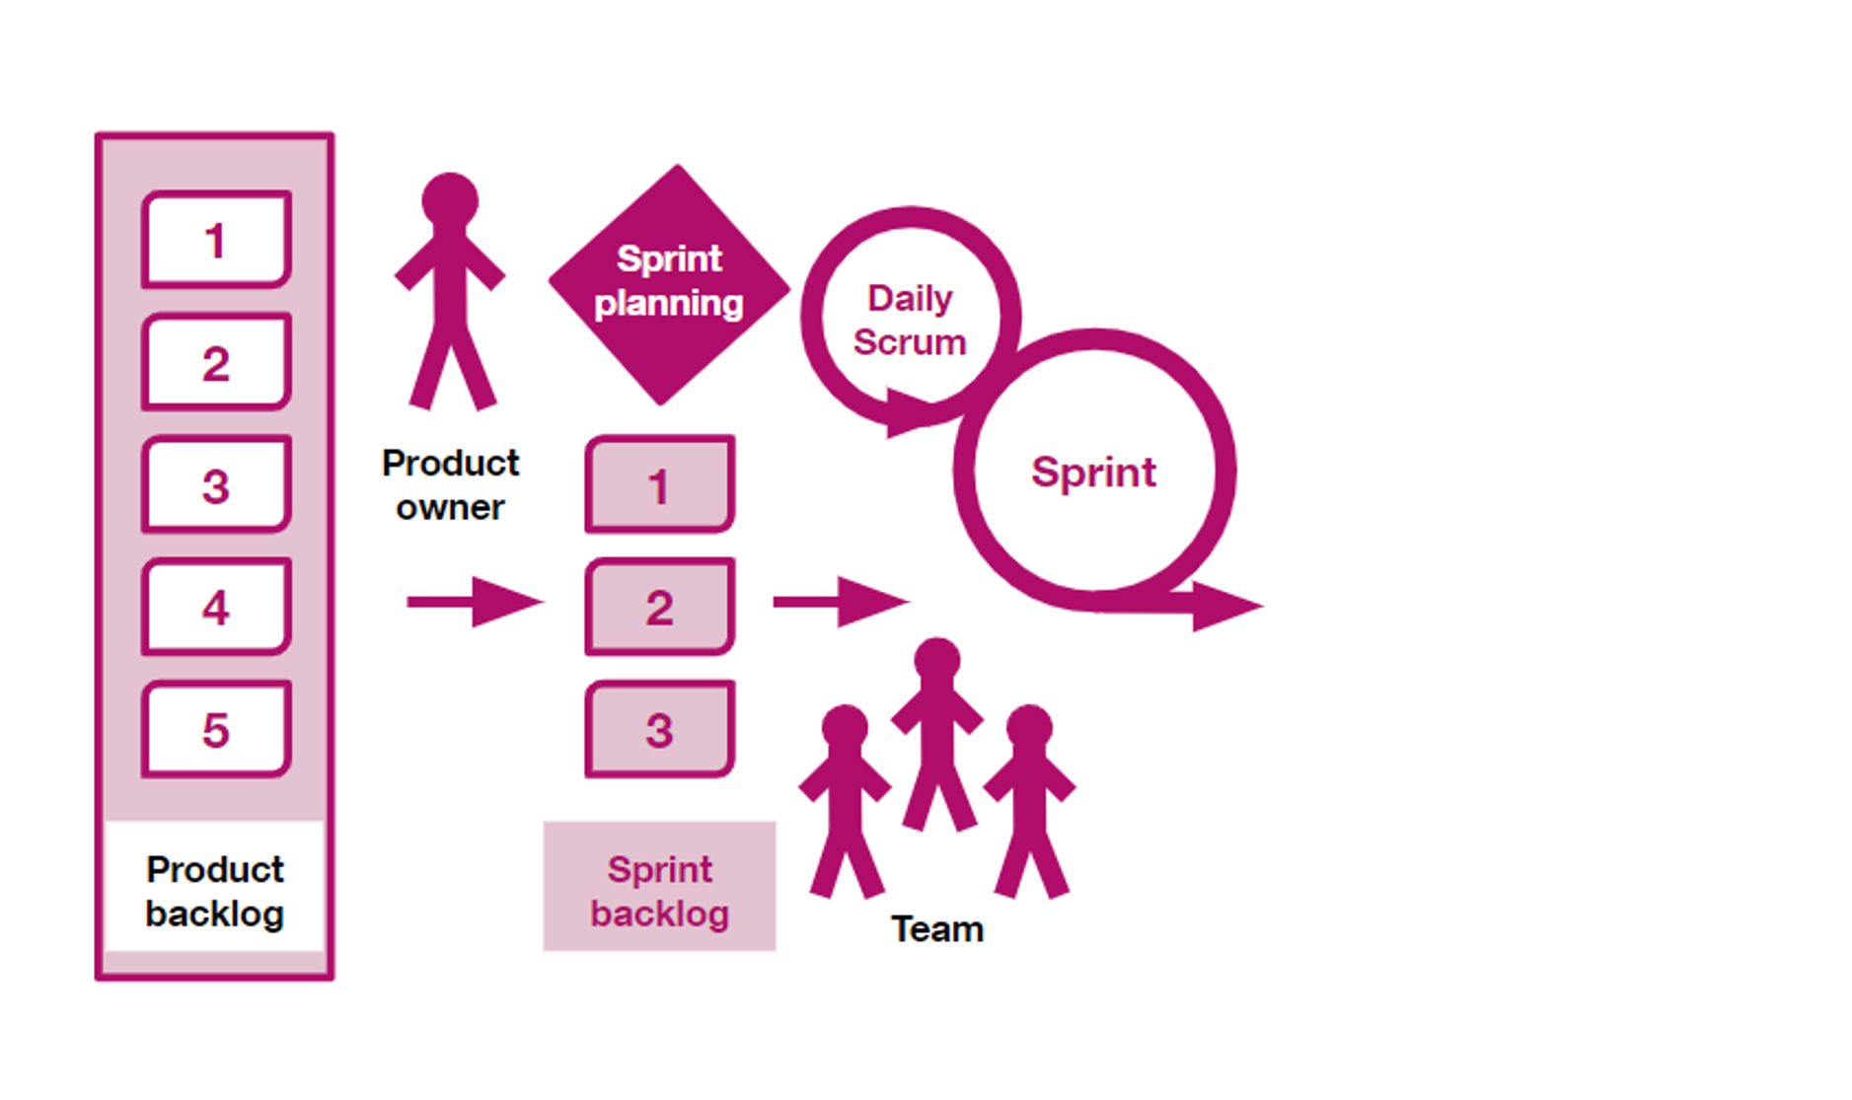
The Scrum method: stand-up meeting
Throughout the sprint, the team gets together in a short scrum meeting.​
​
Usually daily, this is often called the stand-up meeting. ​​
The purpose of this is to identify early on anything that is blocking progress.

Slide 22
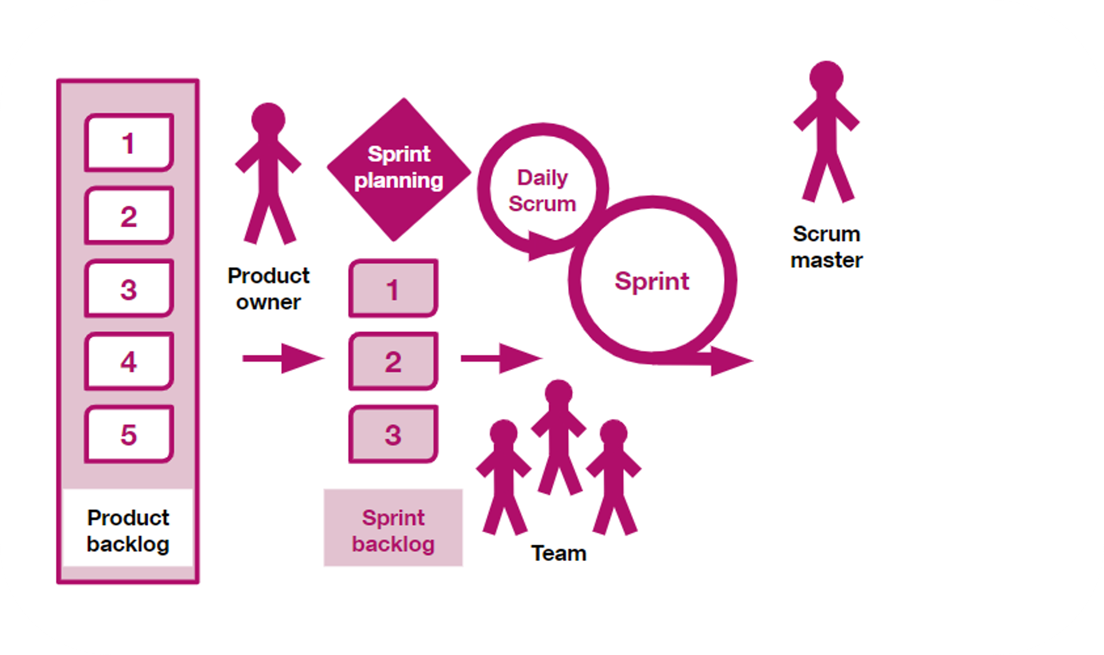
The Scrum method: Scrum master
The Scrum master focuses on helping the team to unblock​ problems or prevent distractions ​
to work as efficiently as possible.
​
They might be called the delivery manager, or Agile coach.

Slide 23
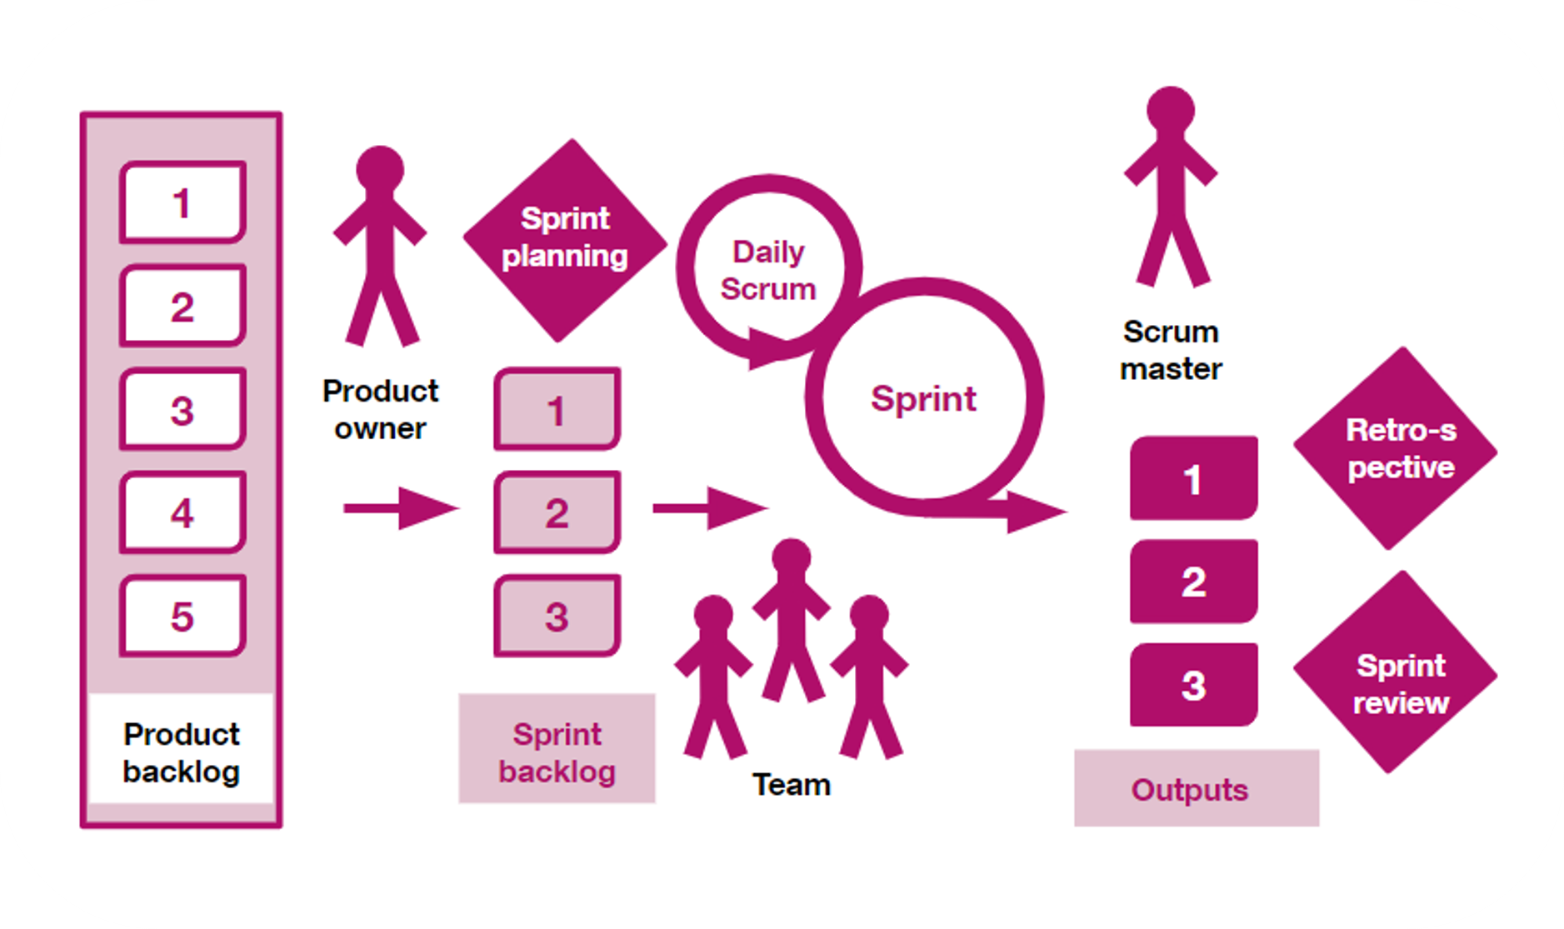
The Scrum method: at the end of a sprint
At the end of a sprint, a review looks at the outputs (increments) and may include a Show and Tell.
​
A retrospective reflects on how to improve ways of working.​
​
There are 3 key roles in Scrum:
product owner
Scrum master
the team

Slide 24
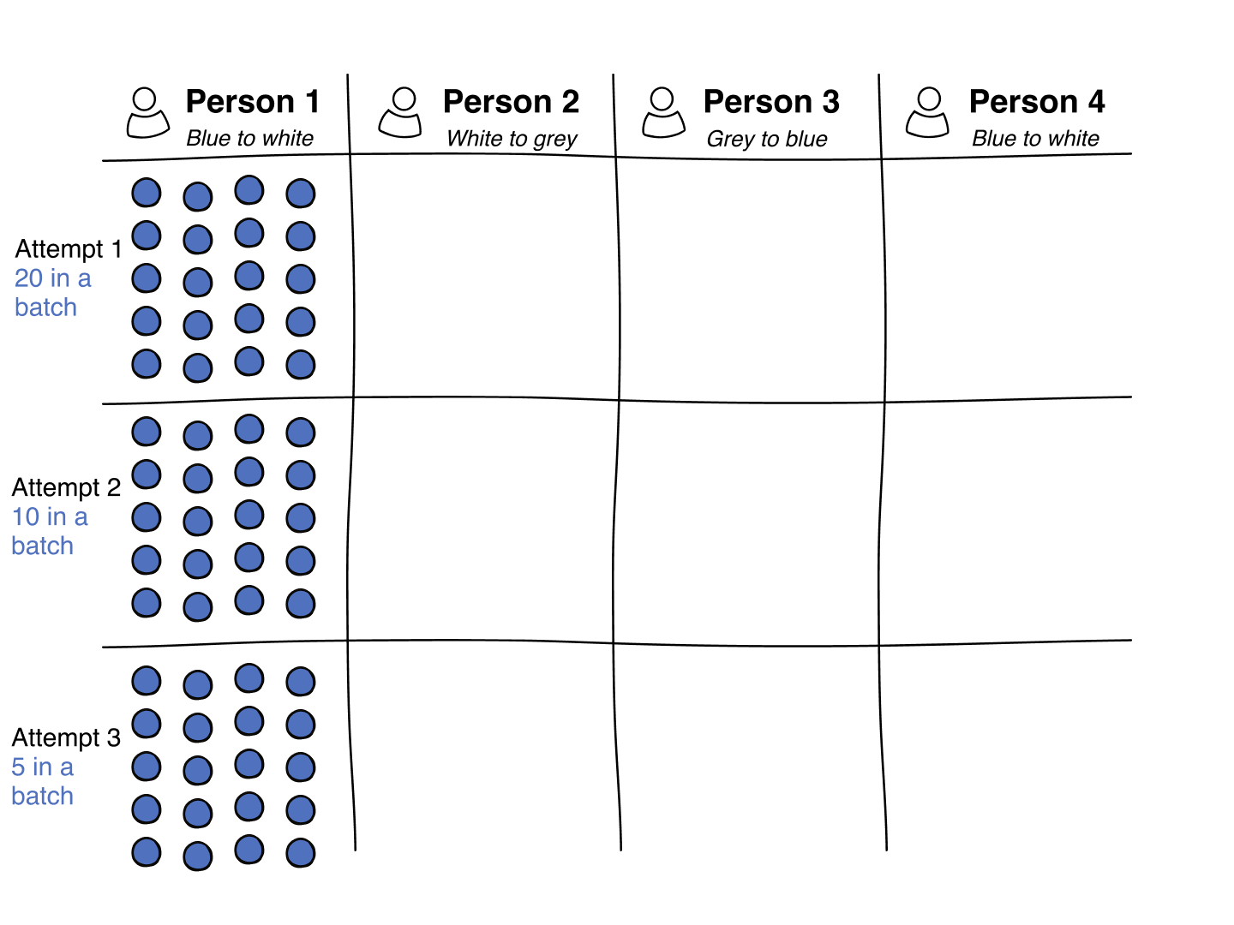
Each sprint should result in viable products
This video shows a task of turning over a set of counters 4 times.
With a Waterfall approach, all the counters are processed (turned over) before passing them to the next person.​​
With a Scrum approach, the counters are processed in batches so usable products are released sooner for the next stage.

Slide 25
The Kanban method

Slide 26
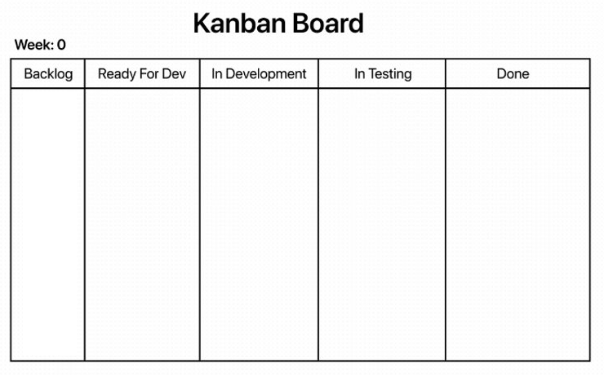
The Kanban method and its origins
Kanban is a Japanese word for sign board.​
The approach was developed in Japanese manufacturing industries in the 1950s.​
​
The process is displayed on a Kanban board, either physical or digital, for everyone to see all stages from definition of a task to its delivery.

Slide 27
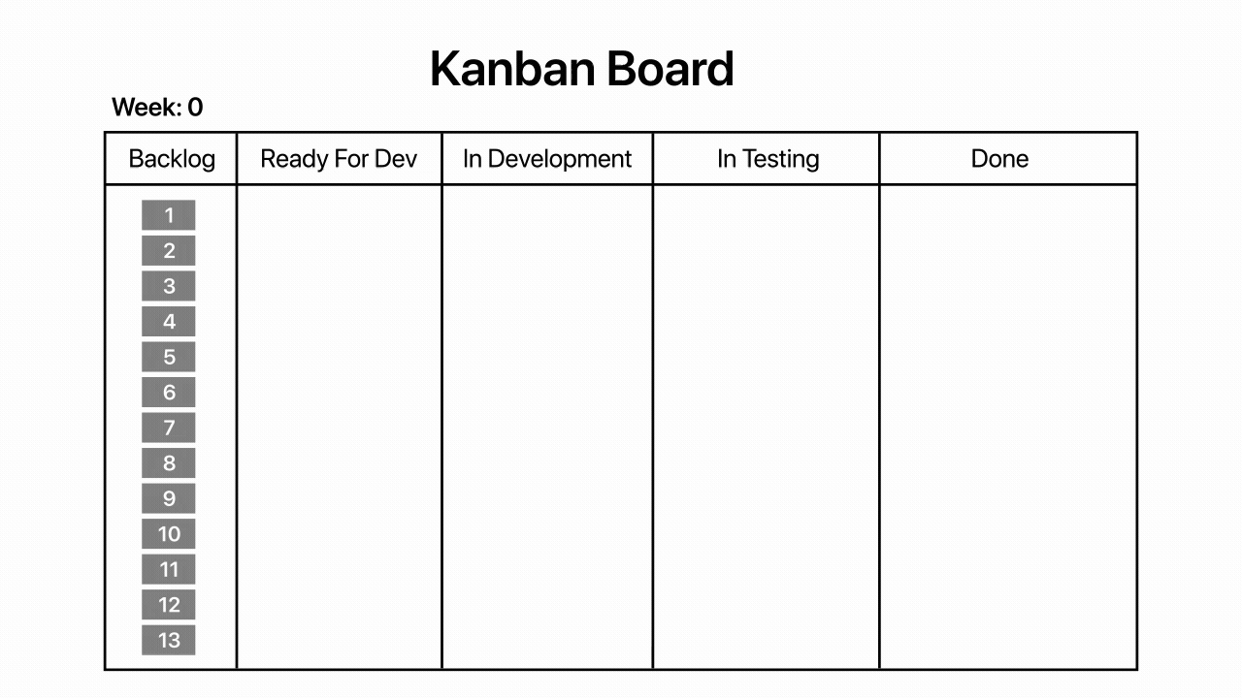
What a Kanban board looks like
In Kanban:
the tasks are summarised as brief cards
columns represent stages of work, or limits on work in progress​​
work continues on a rolling basis to release any improvements as soon as they are ready

Slide 28
Work in progress
An agreed level of work in progress is set to match the capacity of the team. This example shows a work in progress of 3 tasks per column.
The example is for a maximum capacity of 3 similar sized tasks in each column. Some tasks are completed by week 4.
All tasks are completed by week 7.

Slide 29
Kanban delivery
In Kanban:
there are no specific roles related to implementing the Kanban process​
the Kanban board shows all tasks and their status, with daily stand-ups to show any changes to the status of tasks on the board
when a team member completes their work on a card, that person starts on the next highest-priority card that matches their expertise (a bit like a taxi-rank, where each taxi moves off once it has a passenger)
​changes in task prioritisation can be made at any time by moving tasks in and out

Slide 30
Comparing Scrum and Kanban
Key differences between Scrum and Kanban include:
Scrum has the pre-defined roles of product owner and Scrum master, but in Kanban there are no specific roles for implementing the process​
in Scrum, no changes in task-prioritisation should be made after a sprint has started, but in Kanban changes in prioritisation can be made at any time by moving tasks in or out
​Scrum is more appropriate in situations where work can be prioritised in 2-week blocks of focused work ​by the team, but in Kanban work continues on a rolling basis

Slide 31
A hybrid approach: Scrumban
Some teams prefer 'Scrumban', a hybrid of Scrum and Kanban.
In Scrumban:
time is organised in sprints, usually 2 weeks of focused work by the team​
there are pre-defined roles of product owner and Scrum master
the product backlog lists all tasks​
the Kanban board shows all tasks and their status​
daily stand-ups show any change to the status of tasks on the board
changes in task-prioritisation can be made at any time by moving tasks in and out

Slide 32
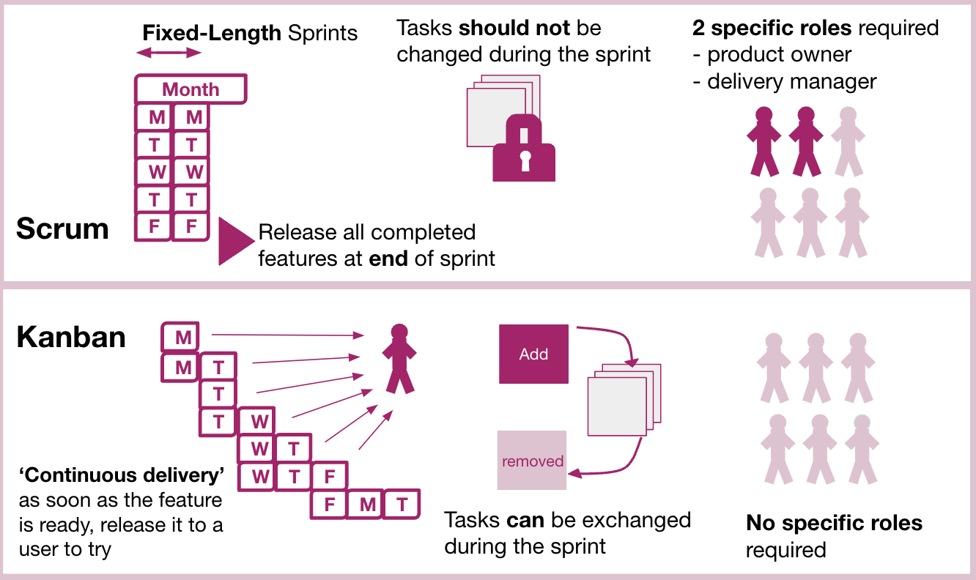
The differences in Scrum and Kanban
Kanban relies on visual tasks to manage workflows.
Scrum helps structure teams and manage their work through ​values, principles and ​mindsets.

Slide 33
Elements of Agile

Slide 34
User stories
User stories describe a user and the reason why they need to use the service you’re building. You must use user stories when building your service. They’re essential to building and running a service that meets user needs.
You should make sure every member of your team writes user stories and uses them to:
track everything they need to do
think about their work from a user’s perspective
discuss their work with colleagues
prioritise their work

Slide 35
User story framework
A user story describes the what, how and why of a user’s need: User story framework: As a = type of user I need to = what the user needs So that = why they need it User story example: As a commuter I need to find an appropriate train So that I can get to work on time

Slide 36
Story mapping example: Release 1
This sequence of slides shows an
example of Release
1 to 3.
Release 1: the basics of buying a ticket.

Slide 37
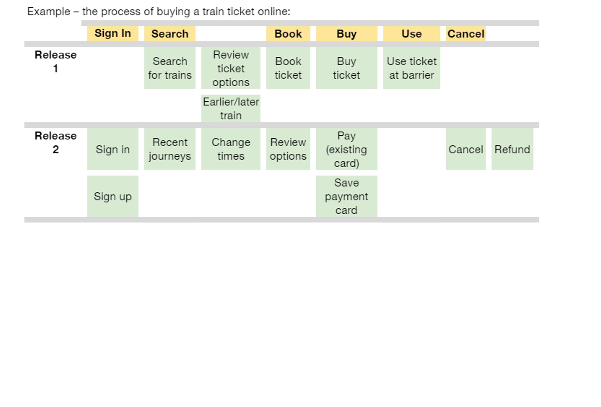
Story mapping example: Release 2
Release 2: iterate with extra features.

Slide 38
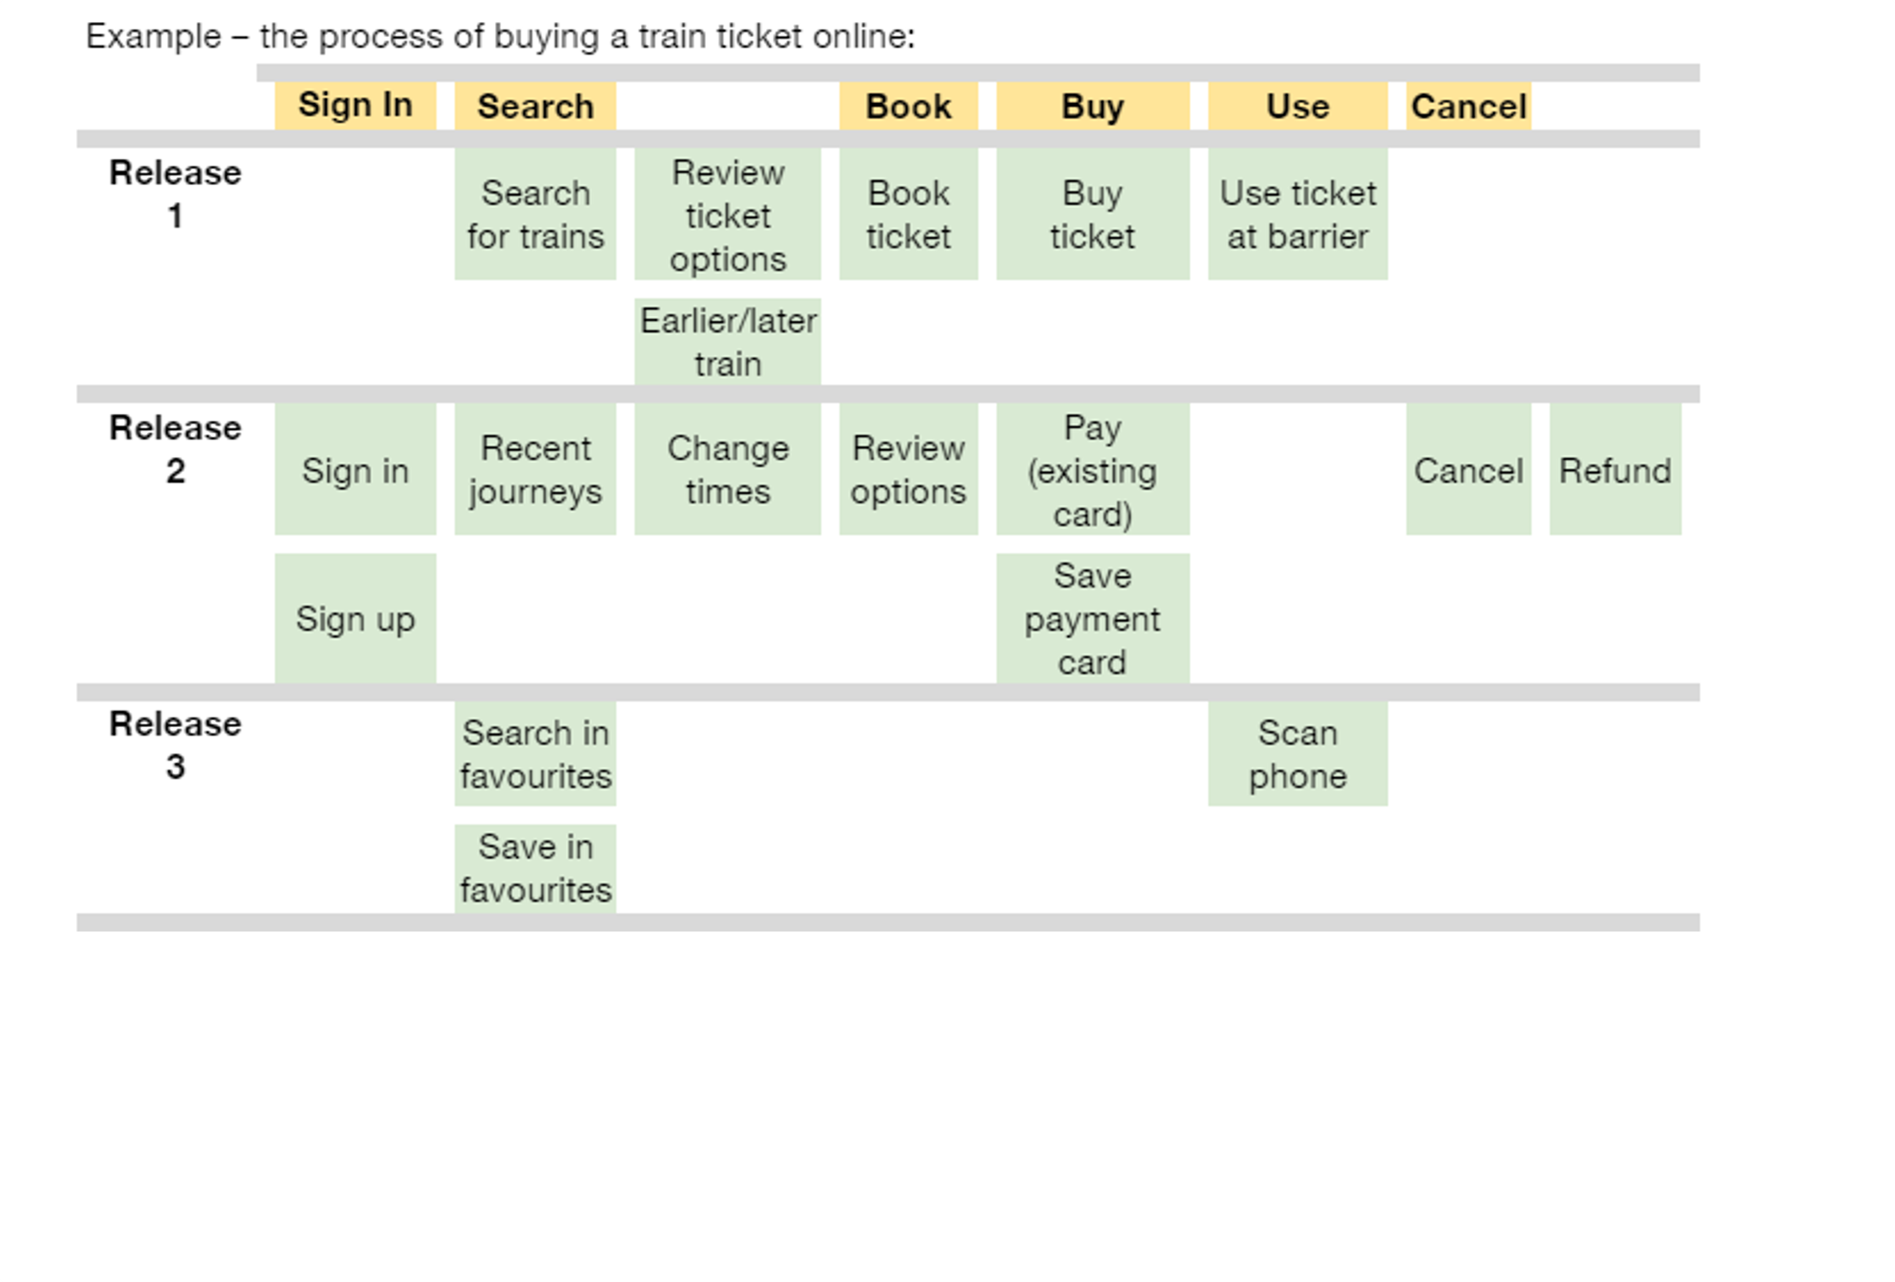
Story mapping example: Release 3
Release 3: iterate with advanced features.

Slide 39
Agile phases of delivery
Many organisations plan delivery into these 4 phases:
discovery - understand the problem that needs to be solved (typically 2 to 8 weeks)
alpha - building prototypes and testing different ideas (typically 6 to 8 weeks)
beta - take the best of the alpha and structure the beta phase to roll out the service to real users
live - supporting the service in a sustainable way, and continuing to iterate and make improvements

Slide 40
Minimum Viable Product
A Minimum Viable Product (MVP) might be the output at any of these stages. It provides the minimum elements that are essential at that stage.
An MVP is a version of a product with just enough features to be usable by early users, who can then provide feedback for future product or service development.
A torch, a lightbulb and an adjustable lamp are all examples of MVPs at the relevant stage.

Slide 41
Agile: useful tools and key jargon

Slide 42
Agile: common jargon
A problem statement is the gap between the current situation and the goal.​ ​
You should make and keep a product roadmap. Find out how to create a product roadmap​. ​
Sometimes a user story might be very large and need to be split into smaller user stories that are each completed in separate sprints. The overall user story is sometimes called a mid or long-term epic, spread over 4 to 12 sprints, across 2 to 6 months.​
Story points are a way of indicating the relative size of tasks. Some teams prefer ‘T-shirt sizing’, where tasks are either small, medium or large. ​

Slide 43
Agile glossaries
You can also use the following glossaries to look up words or phrases you might be unfamiliar with.
​
Agile glossaries:
APM Agile product management glossary (30 words and phrases)
ClickUp 50 Agile terms everyone must know (50)
Agile Alliance Agile glossary (75)

Slide 44
Agile tools
Here are some examples of useful Agile tools.
Planning, user stories, task description and allocation: ​
Trello, Jira, Microsoft Planner and Monday.com ​
Whiteboard tools: ​
Mural, Google Jamboard, Microsoft Whiteboard and Miro​​
Retros: Miro has a library of retro templates​
​

Slide 45
Next steps

Slide 46
Putting Agile into action
Here are some ideas to start using Agile in your day-to-day role:​
discuss the approaches with others in your team – this could be during a team meeting or a lunch-and-learn session​
try using a Kanban approach – this could be for a new project you’re about to start
if you do not have an immediate project, then try using a Kanban approach for a month with your own ‘to-do’ list
talk to other colleagues about their experiences of Agile – this could be colleagues in other councils or organisations you work closely with
share this overview and discuss the approaches with others in your team

Slide 47
Tell us what you thought of this overview
If this overview was useful to you, do share it with your colleagues.​​
​​
Please take a moment to complete our feedback survey (link opens a Microsoft Form). ​​
​​
Thank you. ​ ​

