Slide 1
Service design overview

Slide 2
Welcome to an overview of service design
This Local Digital service design overview aims to cover the basics of service design.​​
The overview will not make you a service designer.​
But it should help you understand how to apply service design thinking in your work. It will also help you to work with service designers more effectively.​​

Slide 3
Who should read this overview?
Anyone who is interested in learning about how service design can benefit your work.
For example, perhaps you’re involved in redesigning a product or service and want to be make sure it is user-centred. Or perhaps you need to work with different teams and stakeholders, and you want to work out how these pieces fit together.
It will also help you work with service designers more effectively.

Slide 4
What will this overview cover?
This overview will cover:​​
what we mean by a service
user-centred service design
end-to-end services
mapping
bringing ideas to life
prototyping
You can also find further resources and tips for ​putting service design into practice in your own context.
Tip: if you are viewing this file in Edit mode, use Control (ctrl) + Click to open any links you want to access.

Slide 5
What is a service?
A service is something that helps someone to do something. Users engage with different types of services.
For example, users may need services such as:
apply for a primary school place
check your bin collection day
apply for a council home

Slide 6
What is service design?
“Service design is the activity of working out which pieces need to fit together, asking how well they meet user needs, and rebuilding services from the ground up so that they do.”
Lou Downe, former Head of Design at Government Digital Service (GDS).

Slide 7
What service designers do
Service designers usually:
conduct research or work with researchers to understand their audience
work with their team to define the problem which needs to be solved, to help users do the thing they need to
identify current challenges and how service design can overcome these
create visual representations of the service to be built or redesigned
think about all the different channels their audience might need to interact with, such as by post, online, phone or in-person

Slide 8
What service designers do not do
Service designers rarely do:
graphic design – service designers will not only focus on the visual design of the final product or service. This is usually led by interaction or content designers
product roadmaps – although service designers will work on different types of service maps (covered later in this overview), product roadmaps to communicate team milestones and timescales are usually led by a product manager

Slide 9
User-centred service design

Slide 10
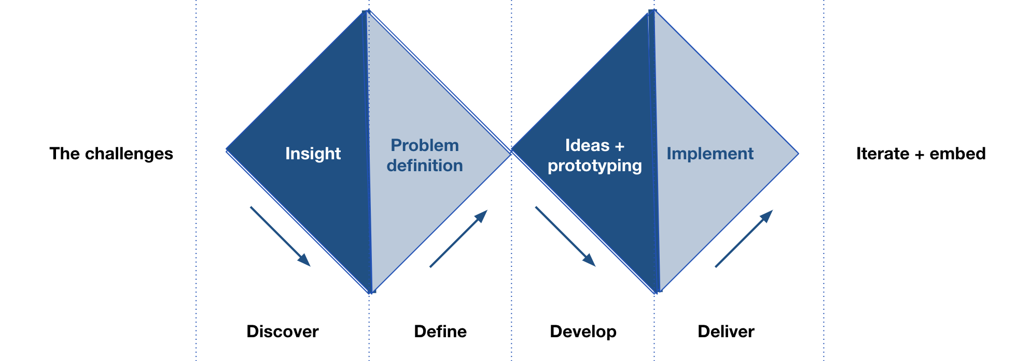
The Double Diamond framework
Many user-centred designers use the Double Diamond framework. This is one way of framing user-centred design, but not the only way. It was created by the Design Council.

Slide 11
Double Diamond: 4 key phases
1. Discover phase – understand the context and get a good understanding of your problem space.
2. Define phase – use research to work out the problems to solve and how to approach them. This is when the team explores the problem to make sure they're designing the right thing.
3. Develop phase – develop ideas for solving the problem, with your team and your users. Start to test if these ideas will work in the real world.
4. Deliver phase – fine tune and deliver the solution, making sure it meets user needs.

Slide 12
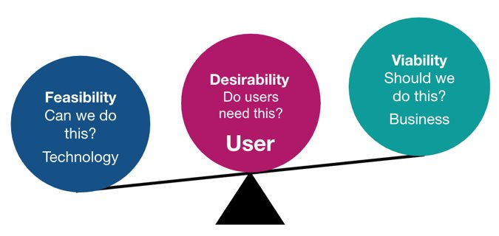
Good design is centred on users
User-centered design is all about putting users and their needs at the centre of every design decision. This foundation is also essential to content design.
User-centred design is about putting users, not technology, at the centre.

Slide 13
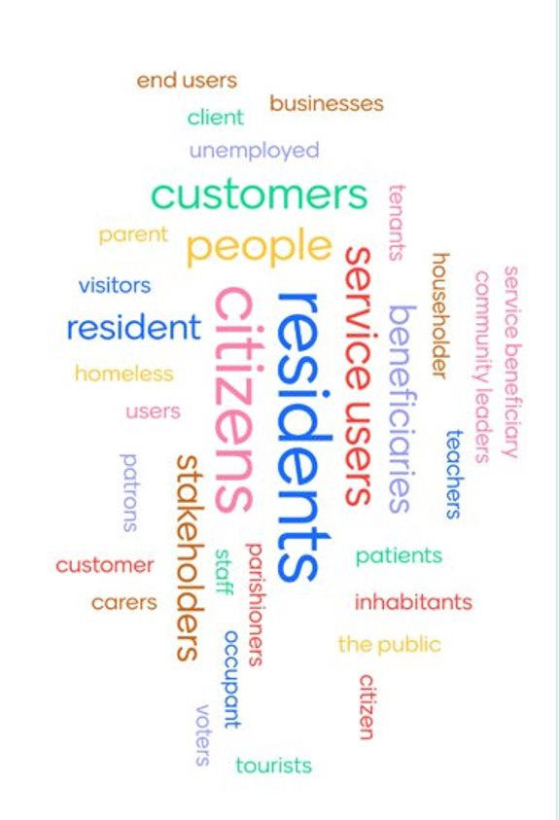
Who is the user in user-centred design?
A user is anyone who interacts with one or more of your products and services. They can be internal or external.
Find the most appropriate word to use to describe your audience on a project-by-project basis.
It may be service user, beneficiary or resident. Whatever is most relevant to your project.
Some projects find it useful to create a few 'typical' users to help sense check ideas. Think of some individuals who best represent your target group.

Slide 14
What are user needs?
User needs are the needs that a user has of a service, and which that service must satisfy for the user to get the right outcome for them. Services designed around users and their needs:
are more likely to be used
help more people get the right outcome for them
cost less to operate by reducing time and money spent on resolving problems

Slide 15
User need example
User needs can be framed in this format: As a = which type of user has this need?
I need to = what does the user need to do?
So that = why does the user want to do this?
Example user need:
As a local resident
I need to understand the local government waste disposal system
So that I can understand what rubbish I can take to the tip

Slide 16
Representing users as a persona
A persona is a description of a fictional user. But they represent a group of real users with shared characteristics.
They help us to think of users as actual people and consider their values, behaviours, motivations, goals and challenges. Personas should be based on first-hand research, such as interviews, and numerical or data-led research, such as surveys. Your personas are only as good as the user research behind them.
Create your personas with your project’s key stakeholders, to increase their understanding and to get their buy in.

Slide 17
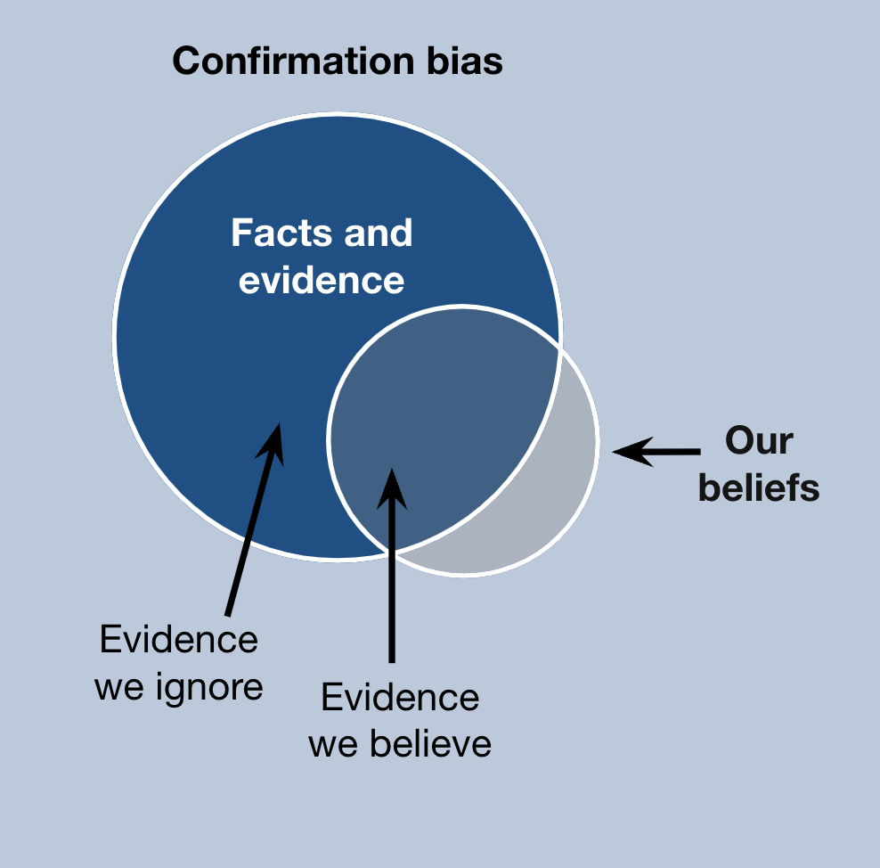
Beware of your bias
With all service design techniques, it’s important to be aware of your unconscious bias. Unconscious biases are social stereotypes, or judgments people make about certain groups of people without realising it. There are a lot of biases that can affect service design. These include confirmation bias, the framing effect, anchoring bias and the halo effect.

Slide 18
Confirmation bias
Confirmation bias is a common bias in service design. It’s important to be aware of this. Confirmation bias refers to our tendency to look for evidence that backs up our initial opinion of someone or something, while overlooking information that contradicts our view.
For example, when creating a persona avoid:
leading names like 'busy Betty' or celebrity names that bring baggage
photos that trigger unconscious bias use ones with minimal detail or use illustrations
including sensitive details such as race, ethnicity, gender, religion or sexual orientation – unless this is very relevant to the service

Slide 19
End-to-end services

Slide 20
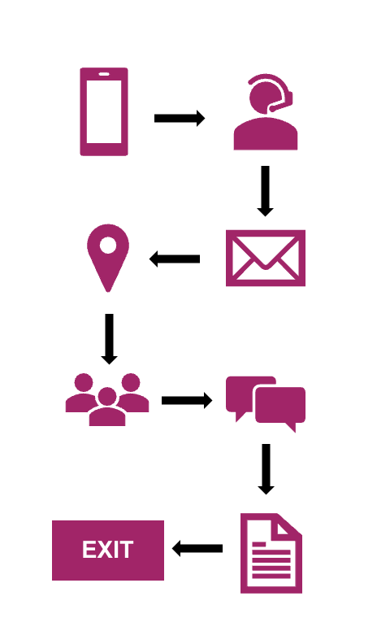
Creating end-to-end services
Designing whole services supports the user from end to end. This means from when the user starts trying to achieve a goal, to when they finish. For example, applying for a school place. Organisational structure can make this hard. There is often ‘red tape’ which makes it difficult to join things up for the user. For example, departments working in silos.
Investing in this approach can transform services. Service designers act as the ‘glue’. They bring together lots of different pieces of the jigsaw, to solve the overall problem.

Slide 21
Problem framing
Framing the problem is an important step in the design process. It can sometimes be a tricky thing to get right.
Once you’ve framed the problem you’re trying to solve, refer to it as you look to iterate and improve what you’re working on.
To help you frame the problem, you can ask these 5 questions:
why are we doing this work?
who are our users, or who would need to use this service?
what outcome will users get from this service?
what outcome are we looking for?
what are our key metrics?

Slide 22
Assumptions and hypotheses
Once you’ve framed the problem you’re trying to solve, the next step is to identify assumptions to test. An assumption is something you believe to be true. Example of an assumption: It is realistic to expect users to trust submitting their information online, not over the phone. A hypothesis then helps you to prove or disprove your assumption. You can use the following framework: We believe that = Users will be willing and able to provide information online. So if we = Ask users to complete the application using our prototype. Then we will see = Whether they would have the ability and confidence to use the digital service, or if they need additional support.

Slide 23
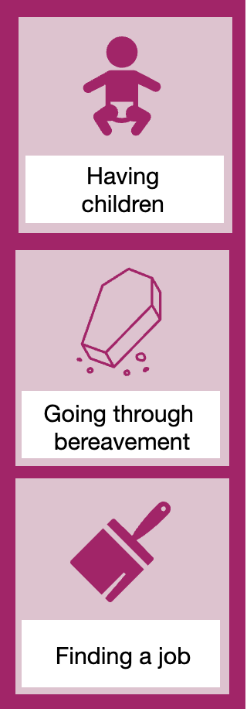
Life events
Life events are an approach to designing services to meet people’s needs. Think of these as trigger points for a user journey or the underlying problem that you’re trying to solve. They are the reason people interact with your council.
Do user research to understand life events. This will help you understand what users do, think and feel in certain situations. This includes understanding emotional and user needs.
Life events include:
having children and adopting
going through a bereavement
finding a job

Slide 24
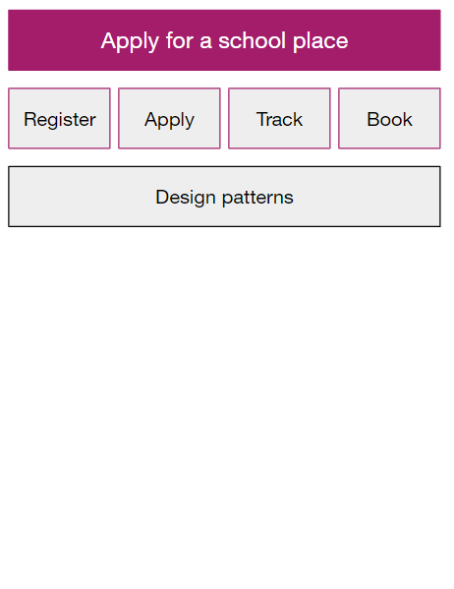
Service patterns
Services tend to have common patterns. For example, ‘Registering a birth’ and ‘Applying for a school place’ sound like very different services. But many services share similar building blocks. These might include registering, applying, tracking or booking something. ‘Registering’ is one step which will be similar in many end-to-end services. You can then identify design patterns for how users will interact with that step. This could be the kinds of questions users are asked. Or, how design elements are used, such as buttons or forms.

Slide 25
Naming services
When naming a service, think about the words your users will be using. This will make it easier for users to find and use your service online. Good service names are usually based around a verb, or a ‘doing’ word. This should be what the user is trying to do.
Do: user research and use search data, such as Google Analytics, to name your service. If your team has a user researcher or content designer, work closely with both. A good example of a service name is ‘Renew your bus pass’. Do not: name your service using internal language, such as the name of a product team or department. Avoid using acronyms, as the user will not know what this means. A bad example of a service name is ‘LAE Portal’.

Slide 26
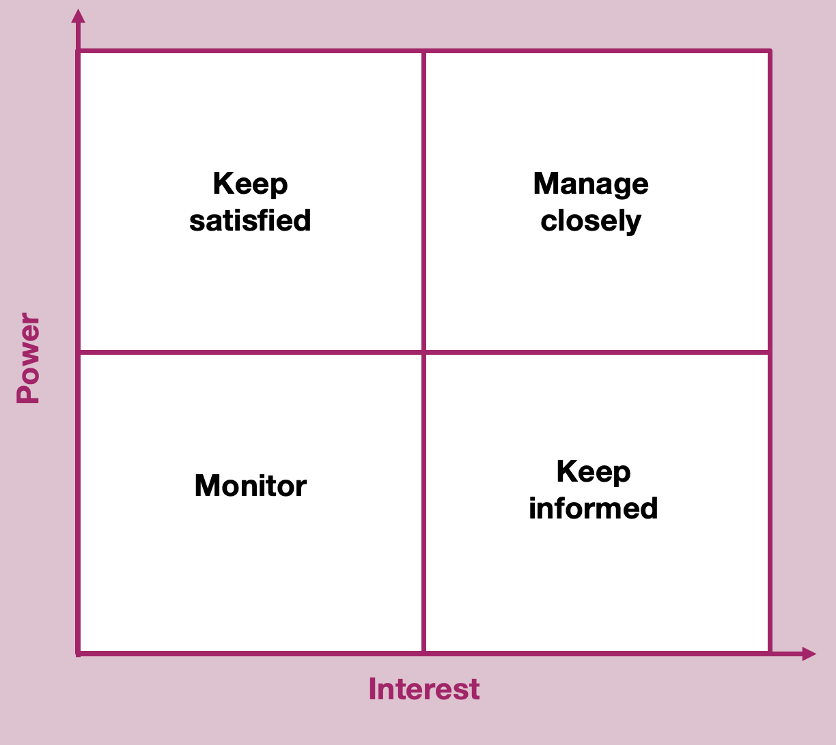
Stakeholder mapping in service design
Stakeholder mapping brings your team together. Map what you know about your stakeholders and their interests. This helps you make sure you have the right voices in the room and think about how you involve them in the project. Maps can be based on different criteria. The ‘power and influence’ version is popular. But you could base it on expertise, relationship, attitude, sentiment, relevance and more. Stakeholders can make or break a project, so it’s important to manage expectations and communicate clearly with them.

Slide 27
Mapping

Slide 28
What do we mean by mapping?
Service designers use maps to make sense of the context they are working in. Mapping a user's whole problem helps make sure the team build the right service for users.
To better understand what a user is going through, teams can look at their overall journey, instead of just focusing on specific details.
In this context, a map is a visual tool that shows how different pieces of information or ideas are connected.
There's no single definition for a map in service design, but it's generally a way to represent the relationships between data or ideas.

Slide 29
Why service designers use maps
Maps are great for starting conversations. They can help the team and stakeholders to understand interactions with a service across touchpoints over time. Maps can be used as a research tool, for planning and operating services, and for storytelling.
A touchpoint is a moment of interaction between the service user and the service provider.
An example of a touchpoint for a user paying their council tax could be:
receiving a council tax bill, physical or digital
visiting Citizens Advice for help applying for a council tax discount
paying the bill online

Slide 30
Experience map
An experience map is focussed on understanding and capturing emotive feedback. This is what people are doing, as well as thinking and feeling.
A good experience map shows both the good and bad parts of an experience people have in a service, from start to finish. It includes what people expect before doing something and how they feel about the experience afterwards.
Experience mapping is a good way to creatively map research insights. As well as to identify opportunities for creating a better, more consistent experience for service users.

Slide 31
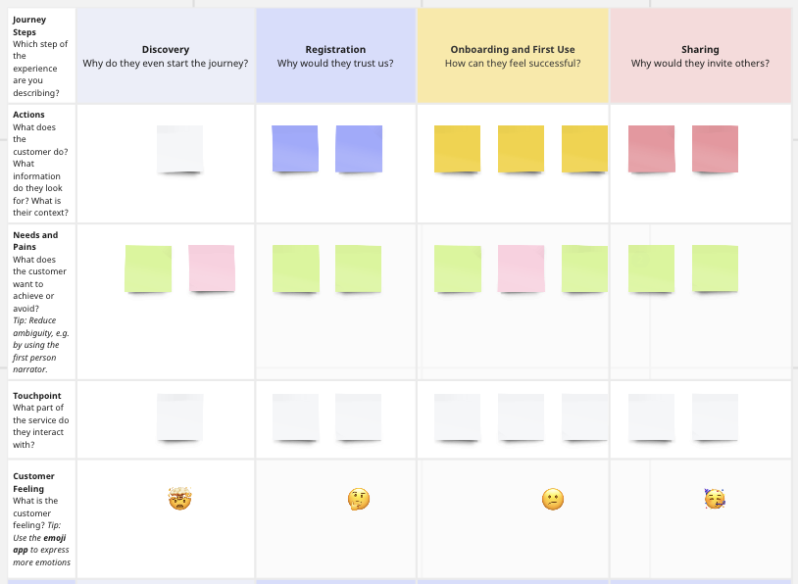
User journey map
A user journey map is not just about capturing feelings. It's more like a detailed guide to how a whole service works, or a part of it. It can either show how things are currently working, like a snapshot, or it can reveal a vision for how we want things to work.
The best journey maps aren't just documents to finish a project. They work best when teams use them to talk and make decisions, giving everyone a better grasp of what users really need in the context of the entire service.

Slide 32
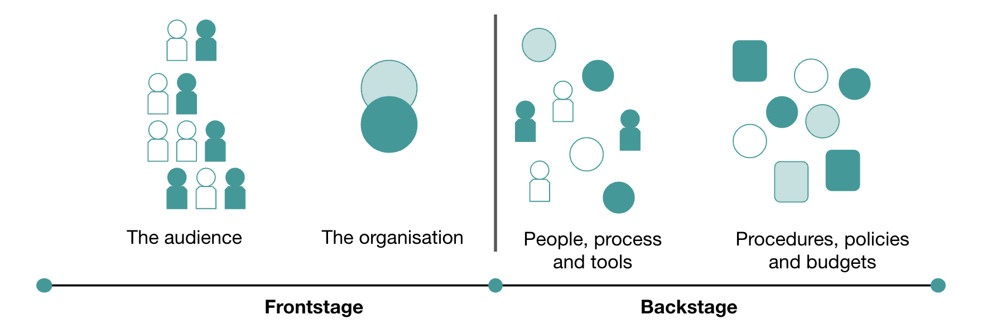
Frontstage and backstage in service design
Service design places equal value on the user experience and the business process. It joins up the frontstage and backstage processes of an organisation to deliver a service experience. The journey map looks at the front stage process.

Slide 33
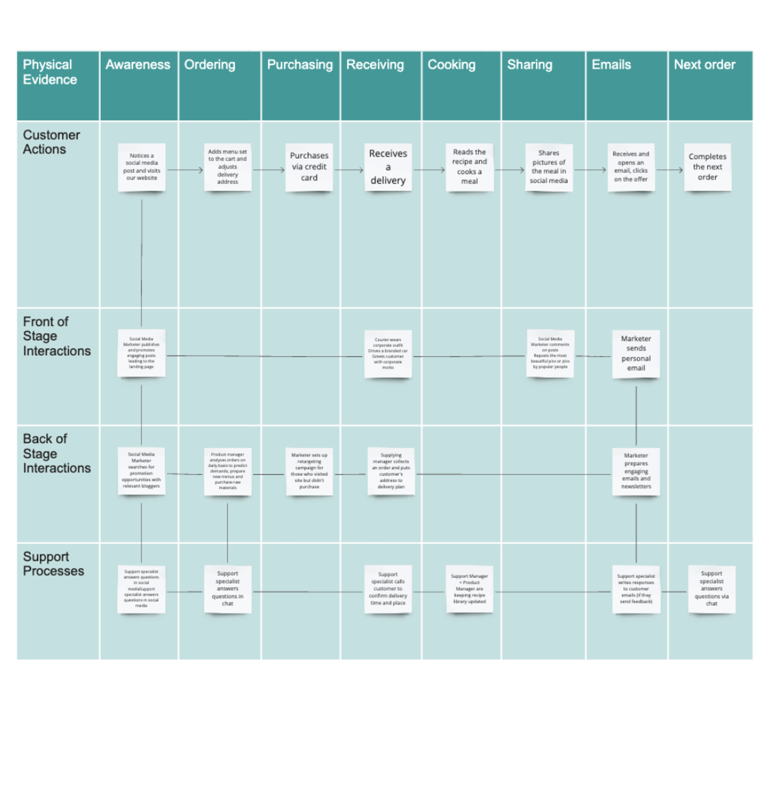
Service blueprints
A service blueprint is a map that shows how different parts of a service, like people, things and processes connect to specific points in a customer's experience. Think of the service blueprint like part two of the user journey map. The journey map looks at the frontstage and the service blueprint pulls thing understanding through into the backstage.

Slide 34
Pain points
Pain points are areas of difficulty or frustration in the product or service that is experienced by the user. The pain point could come from usability, customer service, pricing, or another part of the journey through the service. In the social housing example, a pain point could be a user does not have access to an email and there is no phone line available. The pain points are looked at and prioritised, the aim is to come up with ideas to fix, or even better prevent them. The pain point gives purpose moving forward and are used to develop 'how might we's’.

Slide 35
Bringing ideas to life

Slide 36
‘How might we’s’
The 'how might we' is a question based on the most important findings from user research. It provides a framework for ideation (coming up with ideas) and the possibility to create new solutions. If you can’t think of many ideas, you might need to rework it.
You can use a 'how might we’ to frame a design challenge.
A 'how might we' is a goal + constraint An example 'how might we' could be:
Goal: help boost local residents' confidence in understanding the rubbish they can take to the tip
Constraint: for local residents who do not access official sources of information.

Slide 37
What is ideation and why do we ideate?
Ideation is a creative process of generating ideas for a purpose.
An idea is a thought or suggestion to change something. Ideation will help you to:
solve a problem or meet user needs
ask the right questions
challenge your assumptions
step beyond the obvious solutions
bring together perspectives and strengths of your team members

Slide 38
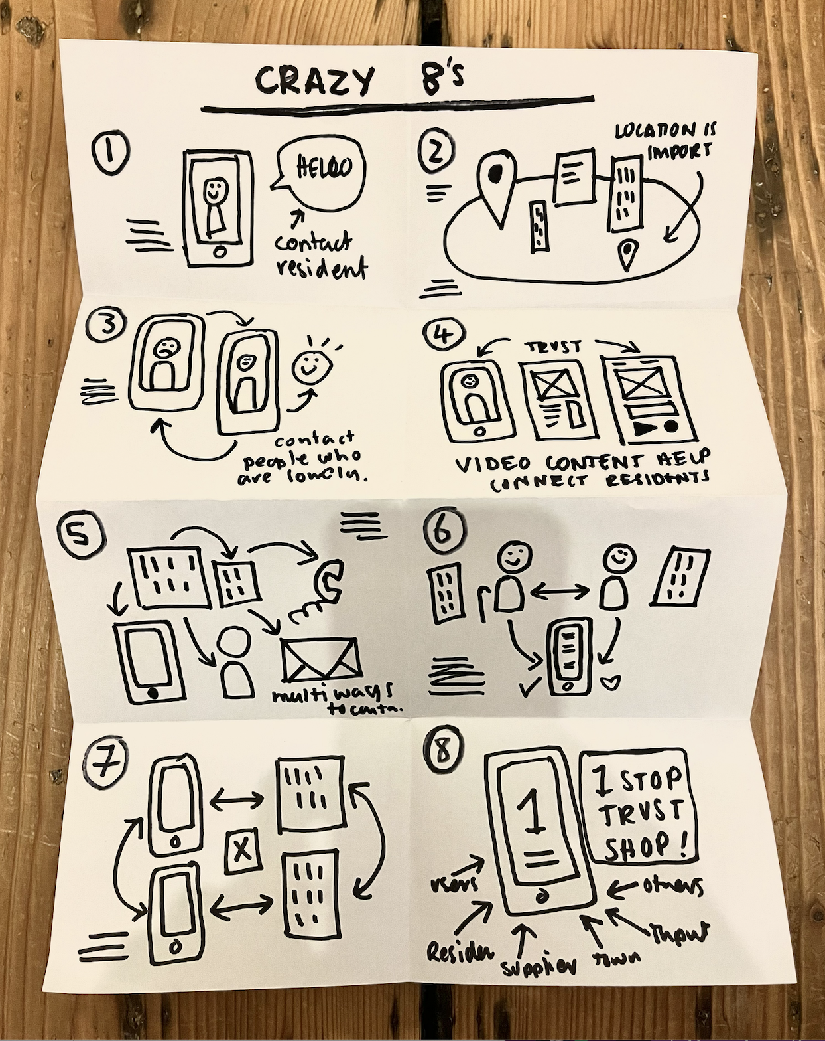
Ideation tools
Service designers can use a range of ideation tools when facilitating ideation sessions. Crazy eights is a fast-paced way of getting lots of ideas from a group in 8 minutes. 10 people in a group can produce 80 ideas in 8 minutes. Silent round robin is slightly slower paced and can help the team build on other team members ideas. Worst idea ever helps free people up because it gives them permission to have bad ideas. You then flip the bad idea into a positive one.

Slide 39
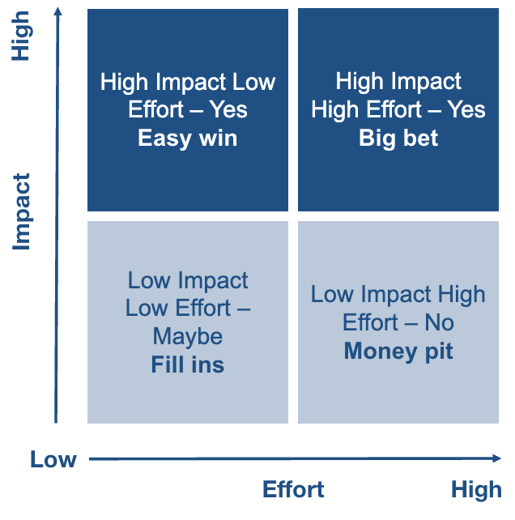
Prioritise your ideas: impact effort matrix
Your team will have lots of ideas, this is good. But you will need to prioritise them. There are several ways to do this, from the impact effort matrix to testing your riskiest assumptions. The impact effort matrix is a way for the team to plot the ideas onto the matrix and discuss things like the idea being high effort, but low impact. Therefore probably not worth taking forward. The aim is to prioritise the ideas in either the top left or right square on the matrix.

Slide 40
Prioritise your ideas: riskiest assumptions
Prioritising your riskiest assumptions helps to understand what to prototype:
write down your assumptions, list the consequences if any assumption is wrong
note your existing knowledge supporting or contradicting each assumption
combine or delete duplicate assumptions
privately score (out of 10) each assumption on its impact if wrong and your confidence in its accuracy
as a team, share and discuss assumptions, agree on consensus impact and confidence scores
time limit discussions to 1 minute per assumption and gather existing knowledge
calculate a risk score for each assumption: Risk = Impact × (10 - Confidence). Higher scores indicate riskier assumptions
sort assumptions by their risk score. The highest score (100) is the riskiest assumption, while the lowest (0) is the safest

Slide 41
Prototyping

Slide 42
Why do we prototype?
Once you’ve developed ideas for solving the problem, it’s time to test whether they will work in real life.
Prototyping allows you to quickly test your assumptions and hypotheses, based on user feedback.
It’s good to involve the wider team in prototyping. This might include designers, business analysts, developers or other roles in your team. If you have a user researcher, work closely with them to create a testing plan.
If you do not have a user researcher, you can still use the techniques covered later in this section. You can also read our overview of user research to find out more about planning and doing user research.

Slide 43
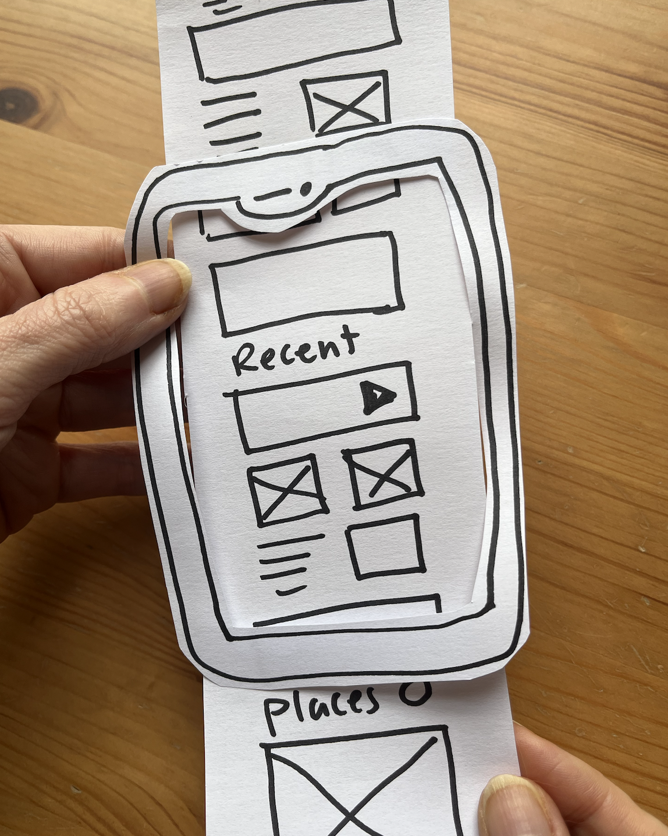
Paper prototypes
Paper prototyping involves creating a paper version of a product or technology.
They do not need to be perfect designs or sketches This makes paper prototyping a good way to get feedback quickly and cheaply.
Paper prototyping can work well in the earlier stages of your project, so you can explore different ideas and refine them.
It’s also a good method to use in group activities and workshops.

Slide 44
Coded prototypes
A coded prototype is built using HTML code. They can mimic the look and behaviour of real digital products and services.
A well coded prototype can help you test your design on a range of devices and browsers. For example, if users are viewing on a mobile phone, or a specific browser such as Google Chrome.
You can use the GOV.UK prototype kit to build realistic prototypes. Although designed for central government, many council’s have adapted the design patterns and components for their own use.

Slide 45
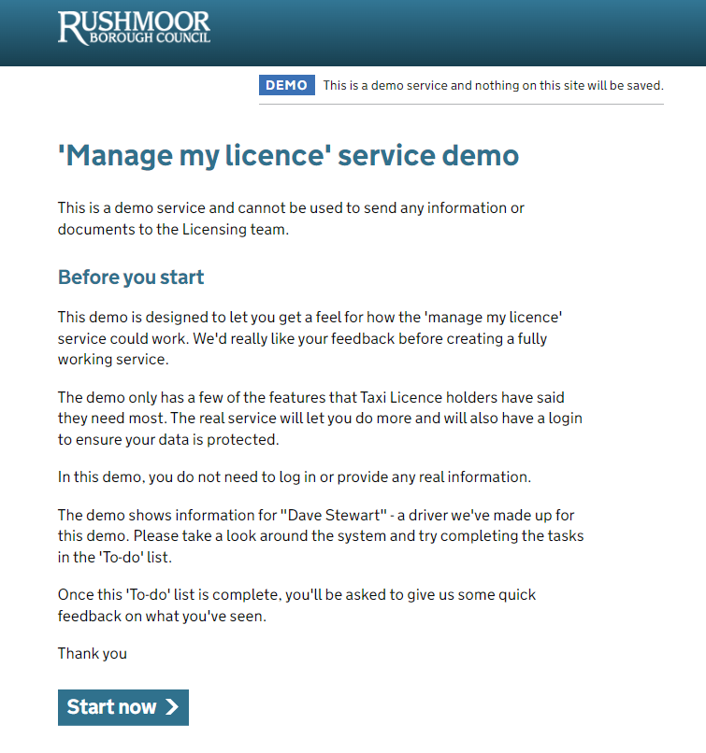
Coded prototypes: example
Rushmore Borough Council developed a prototype for a new service for taxi drivers to manage their licenses. They created an interactive prototype to test their ideas with taxi drivers, operators, and their licensing team.
They found:
licence holders would like email reminders of tasks to be done
how licence holders expect the login user experience to work
the priority of features from the perspective of licence holders and the licensing team

Slide 46
Testing
Once you’ve developed your prototypes, you should test them with real users. If you have a user researcher, work closely with them to develop a testing plan with clear goals. If you do not, you can still plan to use different testing methods such as:
Usability testing – you could run sessions with users, either in-person or remotely. Observe how the user interacts with the prototype. You can also ask open-ended questions such as "how did you feel completing that task?" This kind of testing works well for early designs and concepts.
Unmoderated testing – if you cannot run live sessions, you could use unmoderated testing. This is where users complete tasks independently, using software. This can work well if you want to test with high numbers of users.

Slide 47
Closing services down
You may eventually need to close a service down. This is known as ‘retiring’ a service. Usually, this will be because a user need no longer exists, or a change in circumstances means the service is obsolete. For example, many services related to COVID-19 restrictions were later retired. When retiring a service, you should:
tell your users what’s closing and why – you can send a notification if your service has the functionality, or use other channels like email
use non-digital channels to notify users – including posters
make a plan to redirect traffic – redirect users to the new service if there is a replacement, or a page telling them the old service no longer exists

Slide 48
Next steps

Slide 49
Putting service design into practice
Here are some ideas to start using service design thinking in your day-to-day role:​​
create a problem statement – use the questions provided earlier in this overview to have a clear idea of the problem you’re trying to solve
run a stakeholder mapping session – get your team together to identify your stakeholders, prioritise and think about how to keep them engaged
try paper prototyping – run a workshop with your team or wider stakeholders to create quick and simple sketches of your ideas

Slide 50
Feedback survey
If this overview was useful to you, do share it with your colleagues.​
​
Please take a moment to complete our feedback survey (link opens a Microsoft Form). ​
​
Thank you.

