Slide 1
How to make your content accessible
Tips, tools and best practice for Local Digital funded projects.
Version 1.0, December 2022

Slide 2
About this guide
Projects funded by Local Digital are expected to produce outputs that will be published on our website for other organisations to view and reuse.
It’s a legal requirement for public sector websites to meet the accessibility requirements outlined in the Public Sector Bodies (Websites and Mobile Applications) (No. 2) Accessibility Regulations 2018. This includes content that is available to download via the website.
We have produced this guide to help you make sure the outputs you produce meet basic digital accessibility requirements. It includes simple steps you can follow, as well as advice on best practice and links to useful resources.
We recommend sharing this guidance with everyone in your project team, including any suppliers and contractors you may be working with, before getting started.
While the advice in this guide applies to any outputs you create, it has been designed specifically with written content (such as reports) in mind. GOV.UK has produced a simple but easy to follow guide on making your digital services accessible.

Slide 3
Why accessibility matters
In the UK, 1 in 5 people have a disability. However, the concept of accessibility does not just apply to disabled people – all users will have different needs at different times and in different circumstances.
For instance, someone’s ability to access content could be affected by their:
location – they could be in a noisy environment, outdoors in bright sunlight, or an area with poor WiFi
health – they may be tired, stressed, or recovering from a physical or mental illness that limits their mobility or cognitive functions
equipment – they could be accessing content on a small device such as a mobile phone, or using an older internet browser
This is why digital accessibility is about making sure your outputs can be viewed and understood by as many people as possible.
Read more: UK disability statistics, July 2022 (House of Commons library)

Slide 4
Organising information and writing content

Slide 5
Language
Research has shown that most users, including specialist audiences, prefer simple language as it helps them to understand and process information quickly.
Tips on keeping language simple:
Use Plain English
Explain technical terms, abbreviations or acronyms the first time you use them, for example: ‘Department for Levelling Up, Housing and Communities (DLUHC)’
Avoid unnecessary or excessive punctuation
Avoid using long words when short ones will do, for example, use ‘after’ instead of ‘subsequent to’
Use direct language when you’re giving instructions to get your message across faster, for example: ‘follow these steps’ and ‘read this information carefully’
Use the active rather than the passive voice to make it clearer who is doing what
Keep sentences to 25 words or less for better readability
Read more: Readability guidelines on clear language (Content Design London)
Notes:
Break up this text

Slide 6
Content structure
Consider how you structure your content to help people to easily navigate and understand it:
start with a simple outline that includes the key messages to help you create a hierarchy and organise your ideas in a logical way
put the most important information first
make sure your web page or document has a unique page title that explains clearly what it’s about
use headings to create a logical page structure and assist people who use screen readers to navigate content in a consistent, linear way – see next page for more information
use left-aligned text rather than justified or centred text as it’s easier to read
use bullet points and numbered lists to break up and organise information
avoid long, complex paragraphs – shorter blocks of text are less intimidating for readers (particularly those with cognitive disabilities) and are easier to scan
make your content easier to scan by understanding how people read digital content
Notes:
ADD MORE EXAMPLES

Slide 7
Headings
Headings (or ‘headers’) provide structure and help readers to make sense of content.
Use Heading 1 (or H1) to introduce the content. All documents or web pages should at least have a H1 level heading – generally this will be the title of the page.
Use Heading 2 (H2) for a specific section. Most documents or web pages will only need H2 level headings.
Use Heading 3 (H3) to create subsections within your H2 sections.
It’s best to use sentence case rather than title case for headings, as it’s easier to read.
Read more: Readability guidelines on headings and titles (Content Design London)
Headings example:
I’m the page title (H1)
I’m a section heading (H2)
You can put some content here that relates to the heading above.
I’m a sub-heading within that section (H3)
The content under this heading relates directly to the H3 heading but also to the H2 heading above that.

Slide 8
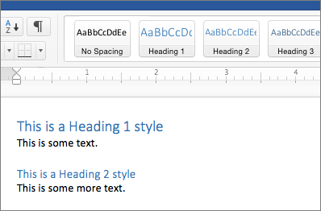
Headings best practice
The order should always be sequential, for example, H1, H2, H3 and not H1, H3, H2.
Do not skip heading levels just to be more specific, for example, do not skip from H2 to H5.
Do not select heading levels based on their appearance, and never skip a header level for styling reasons. Select the appropriate heading rank in your hierarchy.
Do not use bold instead of a heading. One of the most common accessibility mistakes is making text bold when a heading is needed. The text may look like a heading, but the underlying code will not be set correctly, so screen reader users will not benefit.
Microsoft Word provides the option to apply different heading styles to text.

Slide 9
Tables
Example of bad table use:
This table is being used to present a list in a neat way and could be replaced by a bulleted list to improve accessibility.
A table may not always be the best way to present your content.
Screen readers will read the content of a table in a linear fashion from left to right, top to bottom.
Use tables for presenting data, not for changing the visual layout of the page – for example, to present a list in a neat way.
Accessible tables need HTML markup that indicates header cells and data cells and defines their relationship. Assistive technologies use this information to provide context to users. You can also give tables alt text to describe their purpose.
A simple table can often be replaced with a series of bulleted lists with headings and subheadings.
Team member | Job title
Joe Bloggs | Delivery Manager
Jane Stevens | Product Owner
John Jones | Developer
Read more:
W3 Tables Tutorial
When to use tables and how to make them accessible (GOV.UK)

Slide 10
Bullet and numbered lists
Use bullet points to break up long sentences.
Bullet points should:
complete a sentence
be front-loaded with the most important information
start with the same language element (verb, noun or adjective)
Lists should be properly formatted so that it is clear to screen reader users that they are reading items on a list. Simply putting numbers or a symbol at the start of each line does not make it clear enough it’s a list item.
You should also avoid adding paragraph breaks between list items.
Example of a bad list:
1. This is not a properly formatted list item
2. It’s just a number added to the start of each line, and there’s a paragraph break between the lines
Example of a good list:
This is a properly formatted list item
It uses the Numbered List formatting set by this slide template

Slide 11
Web links
Link text should be descriptive and meaningful, and tell users where they are going and why.
A piece of content that features several different links which each say ‘click here’ will be useless to a screen reader user, because it gives no indication of what link goes where.
It’s better to place links at the end of a sentence if possible, as mid-sentence links can be distracting.
Start call-to-action links with a verb if you’re telling people to do something, for example ‘Apply for a passport’.
Make links stand out from other text by underlining them and using a different colour to other content.
Read more:
Linking best practices (WebAIM)
Creating usable hyperlinks (Dan does content)
Example of a bad link:
Click here to subscribe
Example of a good link:
Subscribe to our monthly newsletter
Example of a good link:
Learn more about the Local Digital Fund
Example of a bad link:
Learn more

Slide 12
More resources on content language and structure
Resources on content writing:
Test the readability of your content and make sure it’s accessible to those with lower levels of literacy using this online readability testing tool
For spelling and grammar conventions for content published on GOV.UK, refer to the GOV.UK Style Guide
Find more tips on writing and presenting content on the web
Learn about best practice when writing content for social media

Slide 13
2. Visual information
Images, videos and colours

Slide 14
Visual information: Do’s and Don’ts
Images, videos and graphics can be a great way to communicate and add visual interest to your content, but are common causes of accessibility issues.
Do:
Avoid using images when the same information could be communicated in writing.
Ask yourself: ‘if someone is unable to see the colors, images or video, is the message of this content still clear?’
Make sure to add captions and alternative descriptions (‘alt text’) to your images and graphics, as explained on the next page.
Read more: Accessible images (WebAIM)
Do not:
Rely on images as the only method of communication, because images may not load properly or may not be seen.
Use flashing content as it can trigger seizures in some users or cause discomfort or distraction.
Use content that autoplays (such as GIFs), without giving the user the option to stop or pause the content.

Slide 15
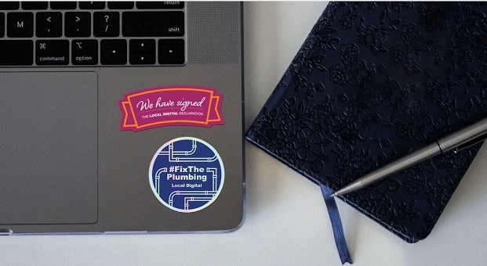
Alt text
Alt text - also known as ‘alt descriptions’ - should always be added to images unless the image is purely decorative, such as a decorative separator between content.
Good alt text should:
let people know what information the image provides
describe the contents of the image
be short, meaningful and specific
feature standard punctuation like commas and full stops
Read more:
Tips on writing good alt descriptions (WebAIM)
How to add alt text in Google Suite and Office 365
Example:
A laptop keyboard with two stickers that read ‘We have signed the Local Digital Declaration’ and ‘#FixThePlumbing, Local Digital’, besides a notebook and pen.

Slide 16
Colour contrast
People with moderately low vision or colour blindness may have difficulties viewing content that has insufficient brightness between foreground and background colors.
Aim for minimum colour contrast ratio of 4.5:1 between your text and the background color. Try this free tool to check your colour contrast.
It’s best to avoid putting text over images as it can be hard to assess the colour contrast ratio.
Text size and weight can also impact the visibility of your content against a certain background colour.
Read more: Why colour contrast matters (Accessibility in Government Blog)
Button with great contrast
Button with OK contrast
Button with poor contrast

Slide 17
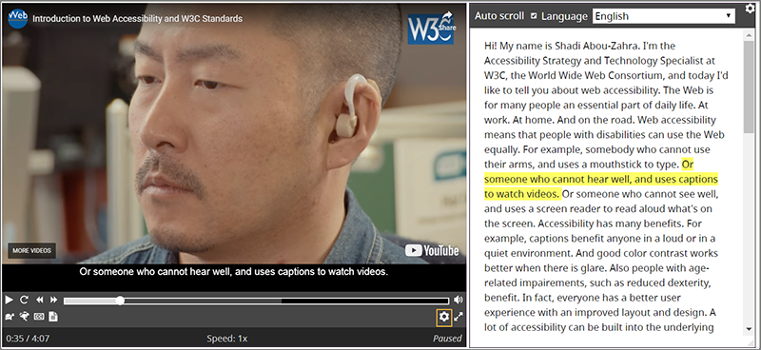
Accessible video
Video content that contains audio should also provide captions (subtitles with non-speech descriptions).
Many video players generate captions automatically, however you should always check that:
the captions are in sync with the spoken content
the people who are speaking are identified when they speak
important sound other than dialogue is included
there are no spelling mistakes!
You should also provide a provide a transcript – a text version of the speech and non-speech audio information that can be read by screen readers and braille readers. This is particularly important for content that has text on screen, but no audio.
If the video contains important visual information, consider including an audio description (an audio track of someone describing the important visuals) in addition to written transcripts.
Example of a good video:
This video provides the option to view captions and a transcript (image courtesy of W3C).
Read more:
Captions and subtitles (W3C)
Video transcripts (W3C)
Audio descriptions (W3C)

Slide 18
More resources on visual information
Read GOV.UK advice on:
Making videos accessible
Making images accessible
Find out how to make HTML charts accessible (ONS)
Learn how to use YouTube captions
Read this blog post on why GOV.UK uses YouTube to host videos

Slide 19
3. Getting ready to publish

Slide 20
Pre-publish checklist
Run through this checklist before you finalise your content:
The content is well organised and structured, and has appropriate headings in place – see guidance on content structure
Any tables used are necessary to structure information and are properly marked up – see guidance on tables
The language used is simple, clear and easy to understand – see guidance on language
Images and graphics have alt text (unless they’re purely decorative) – see guidance on images and graphics
Text and design elements have sufficient colour contrast – see guidance on colour contrast
Videos have captions, a transcript and an audio description as necessary – see guidance on videos
Hyperlinks work and are labelled using accessible link text – see guidance on links
The content displays as expected on different browsers and devices and, where possible, has been tested with different assistive technologies

Slide 21
Creating accessible outputs for the Local Digital website
Please provide us with your project outputs in one of the following formats:
A HTML web page is the easiest format for many assistive technologies to read - if you have the ability to host the content on your own platforms then we can link to it from our website
The next best option is to use the interoperable Open Document Format, rather than Office 365 or Google file types (both Google and Microsoft allow you to export files in Open Document Formats)
If you must use a PDF, it should be properly formatted and ran through a checker tool to highlight and fix any accessibility issues. PDFs are a format designed to be printed, which means they are not responsive and are difficult to open or navigate on mobile devices or using assistive technology. This blog post explains in more detail why content should be published in HTML, not PDF.
It’s also best to avoid sharing documents directly from Google Suite as it may be blocked by some organisations.
Read more:
How to save Office files in Open Document Format
Tutorials on how to improve PDF accessibility
How to make common file types accessible (Accessible Digital Office Document Project)
eAccessibility PDF check tool

Slide 22
More information and resources
These are some resources you may find useful in addition to those linked to throughout this guide.
Resources and guidance:
Understand the accessibility requirements for public sector bodies (Government Digital Service)
Help and encourage people to use your service - follow this advice on accessibility, assisted digital and user support (GOV.UK)
Learn how to make Google docs and presentations accessible
Read Microsoft Office 365 accessibility tips
Get more tips on designing for Web Accessibility, including user interface and visual design
Tools:
The free Grackle app helps you to check and fix any accessibility issues in Google Docs and Slides
Check if a web page is accessible using the WAVE web accessibility evaluation tool
Discover assistive technology you can test with for free
Training courses:
Introduction to Web Accessibility by EdX (endorsed by W3C)
Introduction to UX and accessible design from FutureLearn by FutureLearn
Introduction to Digital Accessibility by AbilityNet

Slide 23
Do you have a question?
Speak to your Local Digital Collaboration Manager or email campaigns@localdigital.gov.uk for advice and support on digital accessibility and creating accessible outputs.
We would also like to hear any feedback you may have on this guide!

