Slide 1
Project Context
User Research
Product Roadmap
Benefits Case
Delivery Plan
Children’s Placements Portal
Beta Submission
October 2022
Narinder Saggu, Birmingham Children’s Trust
Andy Sjurseth, West Midlands Regional Commissioning Hub
Notes:
Essentially, this is accommodation plus care
ResCare Vignette
Home with 2-3 other children
24/7 adult supervision
Cost of 250k-500k per child pa

Slide 2
Guide to Project Outputs
In this Deck
Project Context
User Research Summary
Product Roadmap summary
Benefits Case summary
Delivery Plan
Beta Costs
Sharing the learning
Also available
Full User Research pack
Video of Prototype demo with users
Full benefits case
Time and Motion metrics
Theory of Change
Memorandum of Understanding – partners
Regional DCS approval
Database architecture

Slide 3
“Too often local authorities are faced with little option but to accept high cost options supplied by the private sector, even if that home does not truly meet the specific needs of the child and is far from where the child calls home”

Slide 4
PROJECT CONTEXT

Slide 5
Project Context
User Research
Product Roadmap
Benefits Case
Delivery Plan
Summary
Objective: To provide Placements and Commissioners officers with structured data to manage the broken children’s care market by designing an end to end platform that integrates brokerage, digitised contracting processes and supports market management.
Resources: Local Digital Fund Alpha (£150k) aimed at creating common solutions to shared problems, plus resources in kind from 14 Local Authorities to generate collateral, undertake user research and identify support for digital contracting
Partners
Birmingham City Council, Birmingham Children’s Trust (lead), West Midlands Regional Commissioning Hub on behalf of 14 LAs, Methods (Delivery Partner), Social Finance, DLUHC

Slide 6
Key Players
The West Midlands Regional Association for Directors of Children's Services (ADCS) Network specialises in developing, commissioning, and leading the delivery of services to children, young people and their families. They work in partnership with other agencies to achieve tailored and joined-up services for children, whatever their identified needs. They have members in senior leadership roles for children’s services across the 11 local authorities and three children’s trusts in the region and they are: ​Birmingham Children's Trust Birmingham City Council Coventry City Council Dudley Metropolitan Borough Council Herefordshire Council Sandwell Children's Trust Sandwell Metropolitan Borough Council Shropshire Council Solihull Metropolitan Borough Council Stoke-on-Trent City Council Telford & Wrekin Council Walsall Council Warwickshire County Council City of Wolverhampton Council Worcestershire Children First Worcestershire County Council | Birmingham City Council (BCC) is the local government body responsible for the governance of the City of Birmingham and therefore their reach is wide. Methods Business Digital and Technology (Methods BDT) and Methods Analytics (MA) are already running several projects with BCC across streams such as homelessness and customer service | West Midlands Commissioning Hub is an intended solution to providing fit for purpose services for children, young people and families whilst increasing efficiency and reducing pressures on spend in the region. It works in partnership with LAs and Children’s Trusts.
 | Birmingham Children’s Trust (BCT) aims to make a positive difference for children, young people and families in the city and is owned by, but independent from, Birmingham City Council. | The Department of Levelling Up Housing and Communities (DLUHC) s the centralised UK Government department responsible for the Digital Fund and appointed a Digital Fund Collaboration Manager to work with the project group, and provide guidance.

Slide 7
Project Group
Delivery Manager – Kate Smith ( Lucy Kerslake) METHODS Responsible for the performance of the Methods Analytics team and management of delivery. First point of contact for client queries and communications Adjust plans as required and in line with Agile development practises Build and maintain delivery teams, ensuring they are motivated, collaborating and working well Identify blockers or risks and help the team to overcome them Focus the team on what is most important to the delivery of products and services Facilitate project meetings Responsible for delivering the project to budget Day to day communication with the Delivery Team, Product Owner and Stakeholders Sign off Methods Analytics project timecards Project information governance and access to relevant software | Product Owner(s) – Narinder Saggu and Andy Sjurseth (BCT and WM REGIONAL COMMISSIONING HUB) Responsible for prioritising, planning and signing off on deliverables Provide guidance on the direction of work prior to commencement Signing off on work when delivered Assisting in development of and signing off contract changes Day to day communication with the Delivery Team, Delivery Manager and Stakeholders Responsible for defining tasks and prioritising the product backlog Supporting the PO to communicate the vision and requirements Assisting in removing blockers Attend all Scrum ceremonies
Account Manager – Oliver Bailey / Roger Bearpark METHODS Responsible for owning and building an excellent customer relationship. Assist the Delivery Manager in maintaining a relationship with the client Support the DM in communicating effectively and openly with the PO and Stakeholders Focus on building long-term relationships Generally stay with customers for the length of their relationship with the company, whilst the Delivery Manager may not. Providing information on customer accounts Develop and deliver any new work proposals and specifications Development of contract change notifications to existing contracts. | Stakeholders – James Gregory / Tom Furey (IT&D - BCC) and Anthony Elliott (ITC - BCT), Tom Rintoul (Social Finance) Those with a vested interest in the project being successful as project sponsors. Support the PO to communicate the vision and requirements Sign off development at phase milestones Escalation point if necessary Welcome in Scrum ceremonies but not expected to attend. Interdependencies and co-ordination with other projects

Slide 8
Delivery Group Roles
Business Analyst – Dee Phillips Responsible for translating user needs into technical requirements/ acceptance criteria in line with their goals & user needs. Work closely with the Product Owner, Delivery Manager, Development Team, and other stakeholders to understand and communicate the complexity of delivery. Consider opportunities and potential risks attached Identify the processes and information technology required to introduce opportunities or risk mitigation Translate, document, and clarify all requirements into deliverable pieces of work. Supporting user research and design activities Produce written feedback and reporting on their findings Translate user needs into technical requirements/acceptance criteria. Determining appropriate ways to structure report deliverables and managing content creation for these.
User Researcher – Lisa Astle / Lesley Crane Responsible for the planning, design and facilitation of research activities. Plan, design & carry out research activities with users that help the delivery team get a deep understanding of who might be using the product or solution Build user-centred practices within the delivery team Advocate for inclusive practises within complex user journeys Assist the team in designing and delivering accessible services that work for all users • Connecting people across different sectors and disciplines Carrying out usability testing
Service Designer – Josh Slater Responsible for designing attractive, accessible and appropriately branded user experiences. Working closely with the UR and the BA to design the best possible outcome for users Understand the existing supporting system of service Assess, design and iterate an appropriate service solution that aims to remove complexity Wireframing to demonstrate ideas and concepts Development of no-code prototypes for usability testing Design targeted improvements to that system to accommodate the new service - both digital and process-based
Data Architect / Engineer – David Parsons Responsible for developing data services that meet user needs. Guided by user needs and specifications developed by User Researchers, Service Designers and Business Analysts Design, write and iterate data management solutions Develop code to deliver the solutions from prototype to production-ready Identify, recommend and use the most appropriate analytical techniques for the data solution Explain and demonstrate architecture and/or data solutions that are complex in a simple and accessible way for non-technical audiences.

Slide 9
Alpha Phase 1 Timeline and key milestones

Slide 10
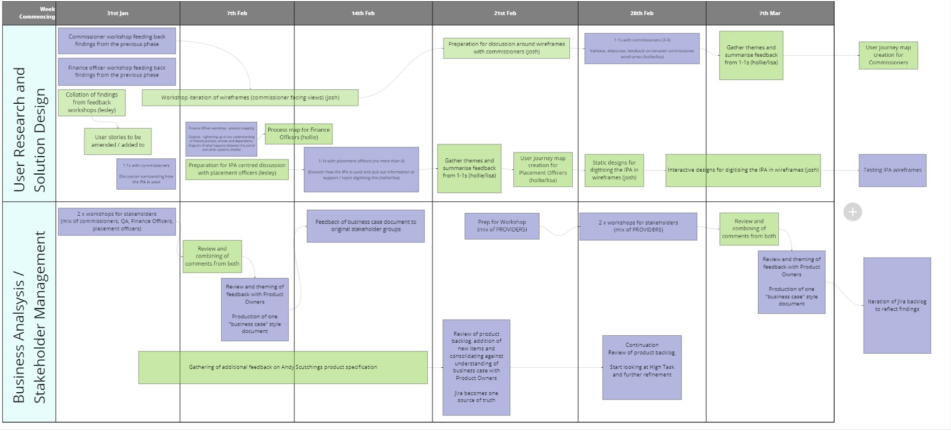
Alpha Phase 2 Timeline and key deliverables

Slide 11
Approach
 | USER CENTRED We put Placements Officers, Commissioners and Providers at the centre of our design process – every new iteration of our prototype is the result of learning from our user research interviews with those who use the Placements Portal everyday.
 | AGILE We followed GDS principles delivered the Alpha through sprint cycles and prototyped through iterations of research with Placements Workers, Commissioners and Providers - every additional round gave us a more in-depth understanding of user needs.
 | COLLABORATIVE We established a cross functional project team and used online and offline communications to establish full engagement with all materials fully accessible on Miro Boards and Jira and Teams.
 | OPEN SOURCE We worked openly and transparently, publicising the project to other local authorities via the Local Government Association and other regional networks such as the West London Alliance, South West, North East Network, Yorkshire and Humber

Slide 12
The Common Problem
Daily scramble across all LAs across the country to find the right home, in the right place, at the right time for children in care, hampered by lack of robust needs data and market intelligence
Rising numbers – 81000+ Children in Care in England; 12,000+ in West Midlands – 2nd highest area region (2021)
Statutory Sufficiency duty – LAs to ensure enough homes for children within their local area i.e. find placements in children’s homes, foster homes, supported accommodation, secure homes
Market capacity - There are 692 registered children’s homes in the West Midlands with a combined total of 2,771 beds. In 2021, WM made 1044 residential placements, only 291 were able to be made within the West Midlands.
Rising costs - LAs spend over £2bn pa on foster and residential care placements from independent providers
Shifting market, shifting occupancy and vacancies levels, shifting costs, unpredictable Ofsted activity

Slide 13
How we find, match, build and run homes for children in care, both foster homes and residential children’s homes, is broken. we have identified four main problems with the way the children’s social care market currently operates
1. Weak oversight
2. High cost and profiteering
3. Poor planning
4. Lack of coordination

Slide 14
Consequences
Poor outcomes for young people: in the WM there are increasing of children with 3 or more placement moves in one year, up by 44% in the last year.
Too much placement activity is crisis driven/ unplanned
Can’t find placements – lack of capacity, particularly for children with more complex needs but limited access to robust data to shape the market.
Children placed inappropriately (residential instead of fostering)
Children placed out of area, far from family and social networks (changes of school, health input etc) e.g. Birmingham has over 1000 children from OLAs placed in the City
Placements disrupt due to inappropriate matching
Price hikes/ escalating costs: 15% increase in weekly fees from 2020 to 2021 (at a time when avg inflation was below 1%)
Notes:
Remove blue highlighted section

Slide 15
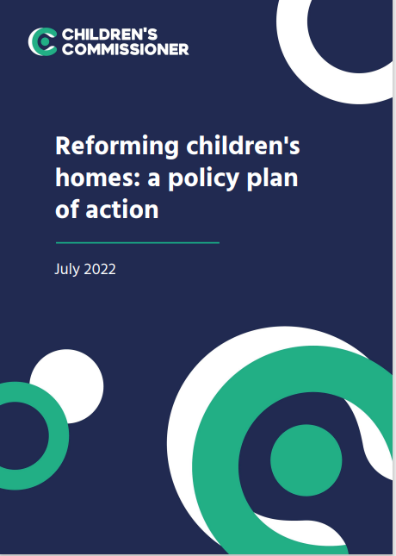
Local authorities have a duty to ensure sufficiency of homes for children within their local area. But the reality is that too few areas have local sufficiency, and as a result many children find there is no place for them, and they get moved across the country or put in a sub-standard home.
At present, one in four children in care experience two or more placement moves across two years. There should be local and national targets to reduce this to less than one in ten children within five years. The national strategy should aim to improve commissioning, improve local area co-operation and implement the recommendations of the Competition and Markets Authority
Notes:
Refer to in presentation

Slide 16
The Commissioning Cycle
Information, data and needs analysis…. is at the heart of the commissioning cycle.
It drives strategic commissioning, impacts on micro-commissioning and placement decisions for individual children

Slide 17
Numbers of Children in Care
Local Authority Interactive Tool (LAIT), 2021

Slide 18
CiC across West Midlands
8500 | 8960 | 9220 | 9560
Foster placements – 2018- 2021: 10% increase
Secure, children’s home and semi-independent living – 2018 – 2021: 32% increase

Slide 19
Inside vs Outside LA Average Standard Weekly Fee
16% of CiC in England placed more than 30 miles from home (22% in some WM LAs (2021) (LAIT 2021)

Slide 20
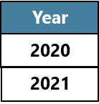
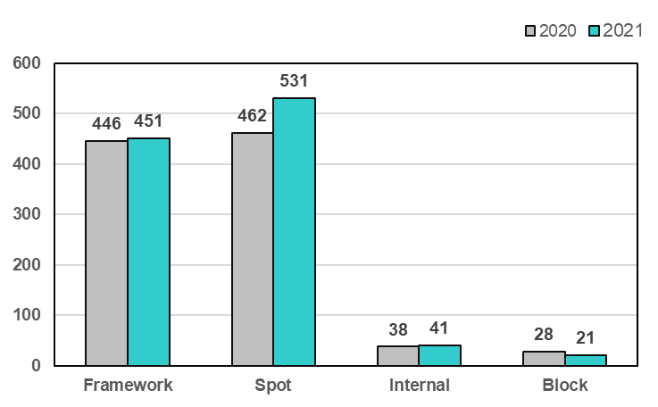
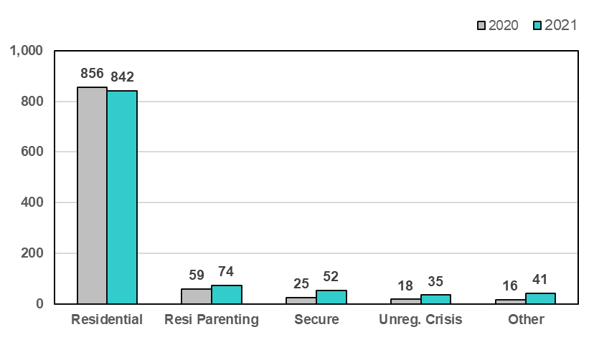
Placements by Contract Types and Placement Types
Placements by Contract Types
Placements by Placement Types

Slide 21
CYP having 3 or more placements in a year
Total Placements
Year
Total Placements
% Change
2020
41
44%
2021
59
7000 (9%) of CiC in England had 3 or more placements moves in a year (16% in some WM LAs)

Slide 22
CONTEXT – CURRENT STATE

Slide 26
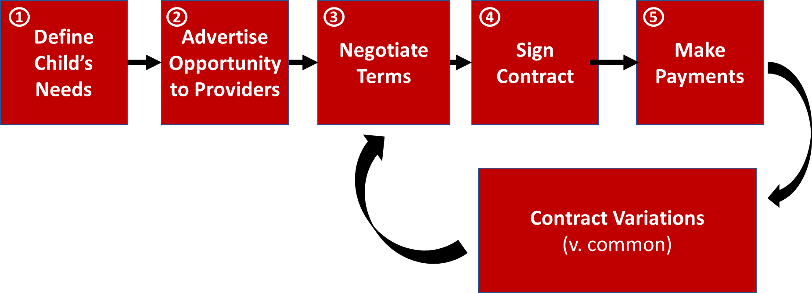
The Process of Buying a Placement

Slide 27
DIGITIZE CONTRACTING FOR PLACEMENTS - Get rid of 135,000 spreadsheets and word docs pa - Finally link finance and activity data so we have the data to manage a broken £2,000,000,000 pa market

Slide 28
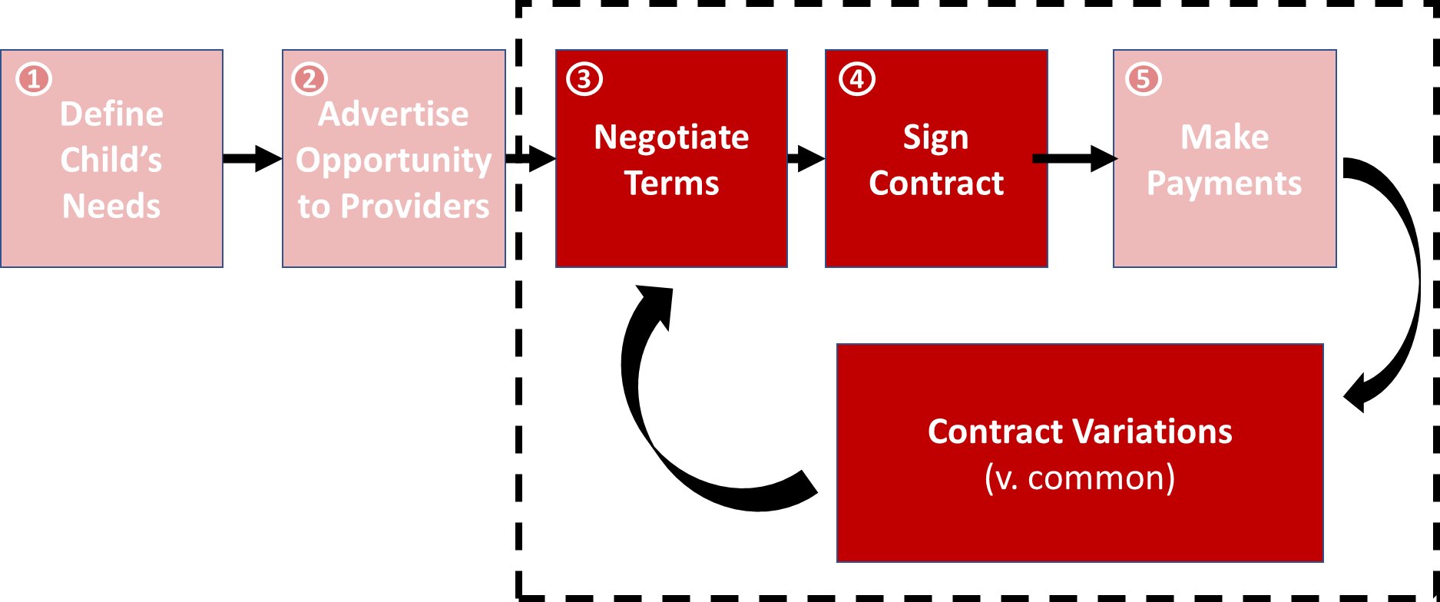
Users’ biggest potential gains are concentrated in contracting, not brokerage
Existing tools are here.
Not here.
Notes:
Enhance and upgrade areas 1+2 – could be better Areas 3-5 are new and happen off grid
– data fragmented, inaccurate, gets lost,
- time consuming for any meaningful analysis
- not in real time or even recent

Slide 29
Why? We Only Structure Data AFTER it Hits the Silos
The Marketplace
Social Work Case Mgmt Systems
Payments System
Contracts Team Files
Placement Team Files
Children and their needs
Placement details, provider, and location
Payments ordered
Contractual terms explaining payments:
Which framework if any;
Tier
Additional services
Number of bids
Spread of offers
Identity of bidders
Referral to placement lag
Referral date/time
Agreement date/time
Notes:
Multiple Interfaces
Fragmentation

Slide 30
What we set out to do
Mission:
Save time for c. 2,200 primary users (buyers and sellers) in the West Mids
Provide commissioners with the data they need to manage this £2bn pa market
Hypothesis to Test: We can do this by digitizing the contracting process (currently 15,000 pa)

Slide 31
USER RESEARCH

Slide 32
Project Context
User Research
Product Roadmap
Benefits Case
Delivery Plan
Delivery Partner: METHODS
User Research undertaken in line with the principles set out in the Government Service Manual.
Phase 1a: Discovery, Interviews and Personas - Placement Officers, Commissioners, Providers, Finance Officers, Quality Assurance Officers
Phase 1b: User journeys and mapping
Phase 2: Wireframe, Prototypes and testing of digitised contracting: Individual Placement Agreements (IPA)

Slide 33
User Research - Summary
Systems users would benefit from intuitive functionality - users
comment on the lack of features such as the ability to select more than one filter, and having to trawl through countless dropdowns
To complete a placement transaction, users have to do many of the tasks OUTSIDE of the portal - e.g. chasing providers by phone when they
fail to respond to referrals – these interactions are not automatically documented in the system audit trail
The General Messages doesn't add value with contacts mostly done outside the portal via email or phone. Users want to accomplish as many tasks and transactions as possible within the system but this is not always feasible or practical.
Users are clear that it would be of significant benefit if Providers were able to 'advertise' new and upcoming placement vacancies (categorised by type), affording placement officers the opportunity to take immediate action.
There's a notably absence of any adherence to W3C guidelines on accessibility. With the system as it stands a user with an impairment (e.g., visual impairment) would find it difficult if not impossible to use.
Placement officers & QA officers spend much time chasing Providers
for up to date information prior to contract placement - it would be good if Providers received automatic requests for them to update their information as and when necessary.
This reinforces the consequences: time wasted on repeated tasks, lack of data, increased placements costs, poor relationship with providers, poor market management

Slide 39
PRODUCT ROADMAP – USER JOURNEYS TO WIREFRAMES

Slide 40
DEMO
Project Context
User Research
Product Roadmap
Benefits Case
Delivery Plan
Methods: User Research within document pack:
Research scripts
Interview outputs
User Journeys
Wire frames
Architecture
Methods: to present excerpts from video

Slide 41
BENEFITS

Slide 42
Benefits case
Project Context
User Research
Product Roadmap
Benefits Case
Delivery Plan
Upgrading and digitising the WM Placement Portal will deliver two areas of benefit:
Immediate cost efficiencies through streamlining and automating the online brokerage process by reducing by 30% the time taken to source a child in care placement. (est. £82k per year at a 60% confidence level in the WM).
Medium to long term benefits by providing more accurate and more timely intelligence to:
Shape the market to provide placements that better meet the needs of children in care
Ensure placements are better value through improved contract terms

Slide 43
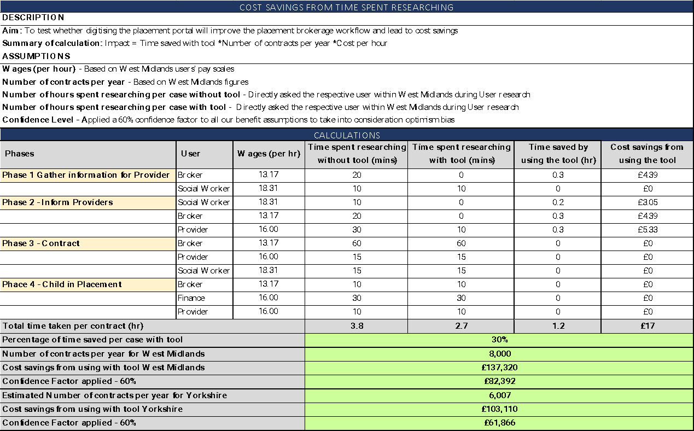
Immediate time and cost benefits
Notes:
These estimated savings are based on digitising the IPA as per the alpha stage of the project. Further savings will be realised as the new portal is developed, e.g. due diligence of providers through an automated and streamlined process

Slide 44
Medium to Long Term Benefits
Current picture:
Commissioners rely on time consuming data collection to inform their decisions.
A limited understanding of:
The needs of children
The state of the local provider market
Inappropriate placements (e.g. out of area)
Increased breakdowns
More costly placements
Future picture:
Placement portal will provide real time data on the needs of children and the market
Better commissioning:
Improved sufficiency of the right placements
Managing the market
Improved outcomes for children in care
Reduced placement costs

Slide 45
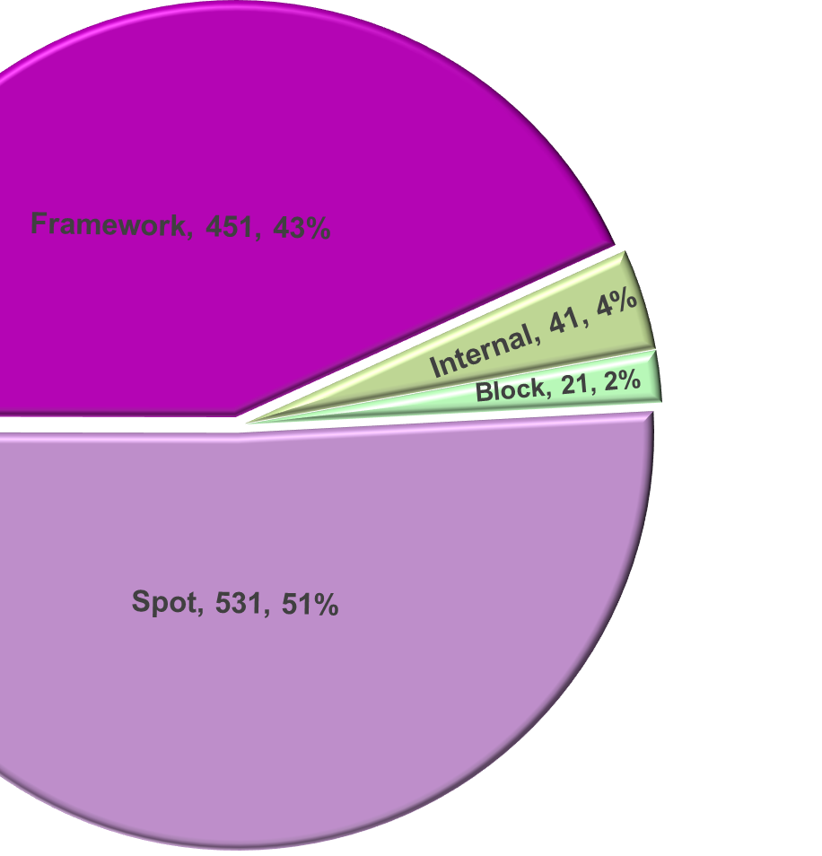
Medium and Long Term benefits
Commissioners buy from the market using a combination of contract types:
Spot contracts: Highest price per placement with lowest confidence of quality
Framework contracts: Provide a discounted price and a level of confidence in quality
Block contracts: Provide the best value price and confidence in quality, but are hard to manage to avoid paying for ‘empty beds’, reducing the cost effectiveness
Limited commissioning intelligence has led to a dysfunctional market relationship
Average prices in 2021:
Spot contracts: £5.2k per week
Framework contracts: £4.4k per week
Block contracts: £3.1k per week
Improved commissioning intelligence leads to the right services at the right price
Modest shifts in the placement market will lead to considerable savings:
Moving 5% of Spot contracts to Framework contracts would save £21,240 per week.
Increasing Block contracts to 5% of total placements would save £65,100 per week

Slide 46
Theory of Change Metrics
 | Outputs |  | Metric | Source of metric | Method of acquisition | When to baseline | Who will baseline | Frequency of monitoring | Who will monitor
 | Data model |  | Standardised and ad hoc reports | Placements portal | Dashboard | During Beta-phase | Delivery partner | Ongoing | Commissioning Hub
 | List of approved providers |  | Market segmentation | Placements portal | Dashboard | During Beta-phase | Delivery partner | Six months | Commissioning Hub/Framework contract lead
 | Report and data exports |  | Breadth of reporting available | Placements portal | Data model | During Beta-phase | Commissioning Hub | Quartlerly | Strategic Commissioning Network
 | Placement brokerage tool |  | Placements made through portal | Placements portal | Portal functionality | Go live | Regional placement teams | Daily | Placement Teams
 | Outcomes |  | Metric | Source of metric | Method of acquisition | When to baseline | Who will baseline | Frequency of monitoring | Who will monitor
 | Improved sufficiency / supply |  | Number of re-referrals | Placement portal reports | Portal Dashboard | Beta-stage | Commissioning Hub | Quarterly | Strategic Commissioning Network
 | Reduction in the number of spot providers |  | Ratio of spot to framework placements | Placement portal reports | Portal Dashboard | Beta-stage | Commissioning Hub | Annual | Strategic Commissioning Network
 | Streamlined process for placing children |  | Time to make placement | Placement officer self reporting | Time and motion exercise | Beta-stage | Placement Teams (x14) | Annual | placement teams
 | Audit trail of conversations between commissioners and providers |  | Log of communication | Placement portal reports | Standard report | Go-live | Placement Teams (x14) | Weekly | placement teams
 | Focus shift towards validation of providers rather than due diligence checks |  | Time taken to validate providers | Level of self service | Portal Dashboard | Go-live | Commissioners (x14) | Monthly | Commissioning Teams
 | Improved placement response times |  | Time taken to receive placement responses | Portal reports | Audit Log | Beta-stage | Placement Teams (x14) | Weekly | Commissioning Teams
 | Informed service development with providers |  | Gap analysis | Market Position Statement | Portal Dashboard | Go-live | Commissioning Teams | Annual | Commissioning Hub
 | Children are matched appropriately to placement providers |  | Number of three or more placement moves | 903 returns | DfE returns | Beta-stage | Performance Teams (x14) | Annual | Commissioning Hub
 | Strategic commissioning based on improved intelligence |  | Needs analysis | Market Position Statement | Portal Dashboard | Go-live | Commissioning Teams | Annual | Commissioning Hub
 | 0
 | Impacts |  | Metric | Source of metric | Method of acquisition | When to baseline | Who will baseline | Frequency of monitoring | Who will monitor
 | Reduction in placement costs, e.g. emergency placement costs |  | Placement prices | Digitised IPAs | Portal reporting | Beta-stage | Commissioning Hub | Quarterly | Strategic Commissioning Network
 | Local authorities do not pay more than they should |  | Average fees paid | Digitised IPAs | Portal reporting | Beta-stage | Finance Teams (x14) | Quarterly | Commissioning Teams
 | Increase in the right placement, first time (reduced dusruption and placement moves) |  | Number of three or more placement moves | 903 returns | DfE returns | Beta-stage | Performance Teams (x14) | Annual | Commissioning Hub
 | More efficient placement process and time saved |  | Time to make placement | Placement officer self reporting | Time and motion exercise | Beta-stage | Placement Teams (x14) | Annual | placement teams
 | Improved safeguarding of children and youg people |  | Number of good quality providers | Ofsted | Portal reporting | Go-live | Quality Assurance Teams | Monthly | WM QA Group
 | Shaping services to commission the right types of placement through improved intelligence |  | Gap and needs analysis | Market Position Statement | Portal Dashboard | Go-live | Commissioning Teams | Annual | Commissioning Hub
 | Improved forecasting and budget planning |  | Average fees paid | Digitised IPAs | Portal reporting | Beta-stage | Finance Teams (x14) | Quarterly | Commissioning Teams

Slide 47
BETA DELIVERY

Slide 48
Project Context
User Research
Product Roadmap
Benefits Case
Delivery Plan
SCOPE
Private Beta
Month 1-6
As Soon As Possible Thereafter
6 months post beta
Priority Backlog
Post Public Beta – c.2023
To be validated with POs
Brokerage and Contracting
Digitised IPA
(All Frameworks)
Ingest of data from current system (2 years TBC)
Easy Referrals for SWs
Generate Referrals from Within Liquid Logic, OLM, or Mosaic
Request for Placement
Aspirational requirements (Narinder)
Workflow between providers and PO
Provider Directory
(Powers brokerage)
Who is available in the area, what do they provide, which frameworks (if any) are they registered on, who is contact for what...
Management of Breakdown of Placement (Andy)
Provider Compliance Mgmt
Manage providers’ provision of proofs of insurance, registrations, etc
(Interface to?) Contract Mgmt
eSigning. Tracking SLAs and milestones. PO mgmt. and scheduling payments. See controcc.
Managing Active Providers/ Placements
Inspections App for Field Workers
Schedule quality monitoring visits, record outcomes.
Outcomes Monitoring
E.g. BERRI surveys for monitoring emotional wellbeing – integrate into main dataset.
Mechanism for loading and managing data to the Portal from providers.
‘Voice of Child’ Surveys
Survey children on their experience, integrate into main dataset
Ensure the right data is captured and made available to analysts at Hub and elsewhere through API
Standard Reports
Development of standard reports at LA and regional level for commissioners and placement teams
Making it Easy for Third Parties to Create Services for Us Using This Data
Description of data (scope, data model, quality) available for third parties (analytics firms, academics) to plan products and research. Synthetic dataset? Interfaces for managing access, payments, etc?
Analytics
Standard DPA and reference DPIA agreed between the 14 to enable data sharing for this analysis
Provider Dashboard
Disclose planned demand and areas of undersupply to providers – to aid expansion planning
Provider Status
Rag Rating (dashboard)
Performance of provider
Infrastructure
Login/Admin
Users and access to system
Control of permissions
Data Model
Lists appropriate to regional variations
API
Replicable Hosting
n.b. unlikely to get all features to the right of this line within the initial 350k
n.b. unlikely to get any of the features to the right of this line within the initial 350k

Slide 49
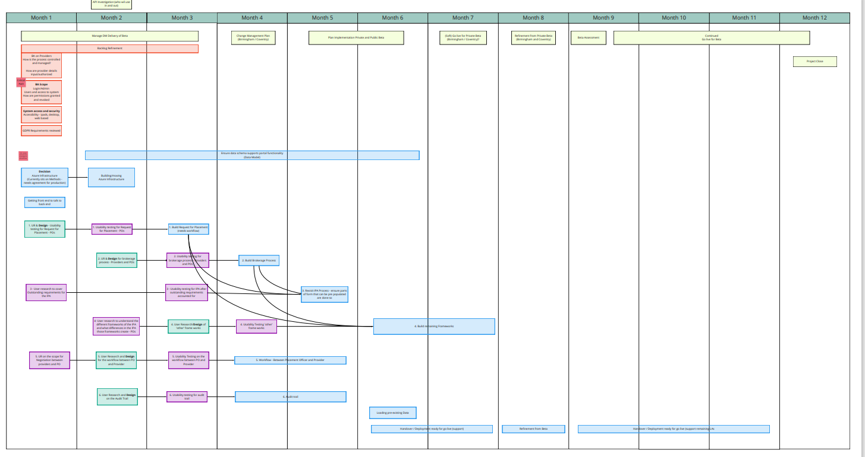
Delivery Plan

Slide 50
Procurement timeline
Activity | Days | Start | End
Project Mobilisation and Governance | 25 | 25/8/22 | 30/09/22
BCC Authorisation | 0 | 12/09/22 | 12/09/22
IT&D engagement | 0 | 12/09/22 | 12/09/22
Portal Project Board | 0 | 23/09/22 | 23/09/22
MOU | 5 | 25/09/22 | 30/09/22
DOS Market Place I (High level business requirements) | 55 | 16/09/22 | 14/10/22
High level requirements | 20 | 16/09/22 | 14/10/22
DOS template | 10 | 10/10/22 | 21/10/22
Procurement Strategy | 10 | 17/10/22 | 28/10/22
DLUHC Bid | 25 | 10/10/22 | 11/11/22
DOS Market Place with high level requirements | 25 | 28/10/22 | 02/12/22
Issue DOS to market place | 0 | 28/10/22 | 25/11/22
Evaluation | 5 | 28/11/22 | 02/12/22
DOS Market Place II (Full business requirements) | 140 | 17/10/22 | 08/05/23
Business Requirements | 35 | 17/10/22 | 02/12/22
DOS Market Place full requirements | 55 | 05/12/22 | 27/02/23
ITT | 20 | 12/12/22 | 16/01/23
Evaluation and award | 30 | 28/02/23 | 10/04/23
Supplier Engagement / Mobilisation | 0 | 08/05/23 | 08/05/23

Slide 51
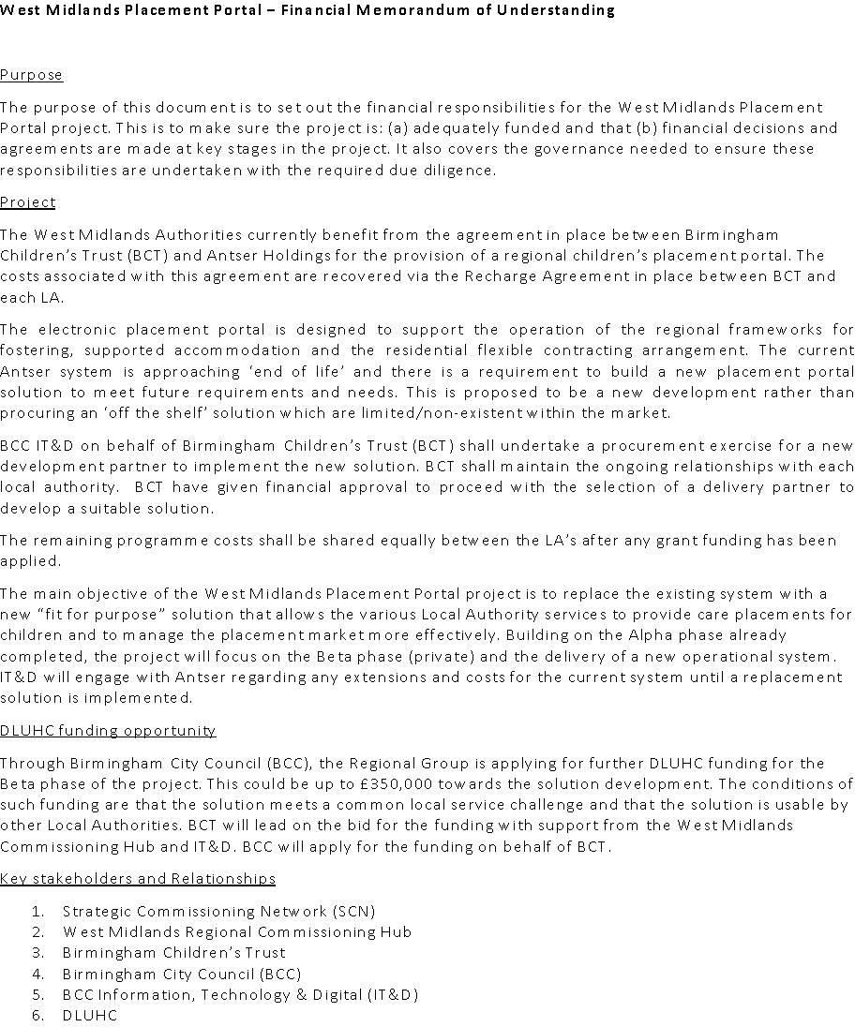
Project Structure and Governance and MOU

Slide 52
Funding - Estimates
Total Estimated infrastructure costs £1.2 m
Private Beta
CF £350k
Public Beta CF £350k
Full Functionality
Dec 22 – March 2023
Procure Delivery Partner through DOS framework
April 2024
PAGE ‹#›

Slide 53
Overview of Beta costs and roles
Infrastructure Costs
Azure SQL Database (Production database) (Implements Layer 1)
Azure Functions (Implements Layer 2)
Beta to Live delivery team - Multi-disciplinary team covering
Research
Business Analysts
Design, Development and data migration
Project management
Delivery
Application Support
System Architecture
Testing
Service Management

Slide 54
Sharing the learning: Alpha Stage
Activity during Alpha Stage
Monthly updates to WM Strategic Commissioning Network
Regular Presentations to Local Government Association Commissioning and Procurement Network
Updates to other regional commissioning groups including:
Commissioning Alliance
Placements North West
South West
White Rose Partnership

Slide 55
Sharing the Learning: Beta Stage
Formal sprint updates to regional networks to:
Share progress
Seek views on progress and to inform next steps of the development
Social Media presence through blogs via BCC Communications and regional networks
Continued monthly updates to WM Strategic Commissioning Network
Continued regular presentations to the Local Government Association

Slide 56
Conclusion
Overarching Hypotheses : if we digitised the contracting (IPA) process, then we could capture the data which commissioners need to manage this broken £2bn pa market.”
By testing the hypotheses and prototyping, we learnt
We Can Capture the Data - The data we need could be captured during in the brokerage and contracting process, without creating such new burdens or inconvenience for the portal users that they resist the change.
The Data is Actually Valuable - Commissioners can articulate decisions they are trying to make, what they might do differently with better analysis, what that analysis would need to look like, and how this would lead to sufficient impact for children in care, and savings for the LAs.
No Impact on Finance Workflows - change to Placement Portal workflows cannot break the flow of data on ‘who should be paid what when’ which currently goes to finance teams in each LA.
£82k time saved pa from alpha stage improvements alone
To be progressed in Beta :
% error rate vs old manual process?
Effectiveness of supply & demand management?
% changes to commissioners cost estimates for next planning period in £m?
Notes:
Modest shifts in the placement market will lead to considerable savings:
Moving 5% of Spot contracts to Framework contracts would save £21,240 per week.
Increasing Block contracts to 5% of total placements would save £65,100 per week

