Slide 1
WHAT WE DID
Research and design activities

Slide 2
Overarching questions
LINK TO ALPHA PLAN
Following the inception workshop we prioritised and formulated our overarching questions for alpha to select the right methods and participants. We captured our thinking in a high-level plan: What are the challenges with diagnosis and how might the service improve it? How could the service improve reporting, booking, tracking and visibility of repairs for residents? What repairs should not be handled online? And what repair journey should we experiment with first? What are the components of a viable service pattern across participating authorities? And how can it be shared? What technology constraints are there across participating authorities?

Slide 3
We worked in three two week sprints. We designed the activities in each sprint to deliver maximum input for the pattern

Slide 4
SPRINT 1
SPRINT 2
SPRINT 3
Mapping workshop
Usability testing
Call centre
observations
Design workshop
Design
crit
Usability
testing
Prototype
Version 1
Prototype
Version 2
Research with internal users
Research with residents

Slide 5
What we did | Why we did it | What happened | Outputs
Mapping workshop | To walk through a resident’s experience of housing repairs with the council and understand how repair problems are diagnosed. | Four, two hour workshops took place with Southwark, Greenwich, Lincoln and South Kesteven repair team staff.
Usability testing - round one | To evaluate the usefulness of the first version of the prototype with council residents. | 4 residents took part in usability research. | Analysis miro board Show and tell 1 slides
Observations | To find out how customer service teams at Lincoln and South Kesteven handle different types of housing repairs requests. | Two observation sessions took place with customer service agents from Lincoln and South Kesteven | Show and tell 2 slides
Design workshop | To explore and visualise the common steps involved in reporting a repair and to generate new ideas for dealing with a repair request (sketching). To gain further insight into whether the current prototype gathers the required information for processing a repairs request (design crit). | One design and sketching workshop took place with customer service agents from Southwark and Greenwich.
Design crit | To improve on the first design of the prototype by involving different perspectives. | Two design crit sessions took place with customer service agents from Southwark, Greenwich, Lincoln and South Kesteven
Usability testing - round two | To evaluate the usefulness of the second version of the prototype with council residents. | 4 residents took part in usability research. | Analysis miro board Show and tell 3

Slide 6
Testing with council residents

Slide 7
8 in-depth testing sessions with council tenants online and face to face.
We tested prototypes with 8 residents across two rounds of testing. All had some experience with leaks, drips, mould, damp, condensation.
We had a good mix across:
Age (up to 72 years of age)
Digital inclusion
Location
Type of property (flat vs house)
Living with others (kids, partner, alone)
Accessibility needs (wheelchair, English not first language
Only one participant identified as male but gender is unlikely to have significant impact on users’ needs or how they approached the service.
Age group
30 to 39 | 45 to 54 | 65 or older
3 | 2 | 3
Council represented
Greenwich | South Kesteven | Southwark
3 | 2 | 3
Property type
House | Flat
3 | 5
Living ...
alone | partner only | children only | partner and kids
3 | 1 | 1 | 3
Type of session
online | cafe (F2F) | home visit (F2F)
4 | 2 | 2
Device used for testing
Tablet | Smartphone | Laptop or MacBook
2 | 2 | 4

Slide 8
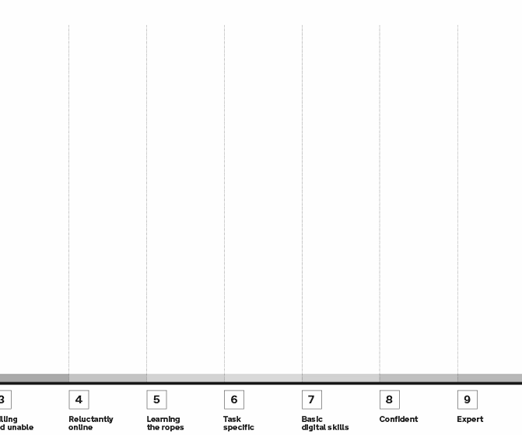
PARTICIPANTS’ DIGITAL INCLUSION
All participants had some digital skills and a method to access the internet.
Some didn’t have a smartphone or internet access at home but were willing to report online anyway.
8
7
5
4
6
2
3
1
*Scores are approx based on GOV.UK digital inclusion scale

Slide 9
2 ROUNDS OF TESTING
Examples of real scenarios
1 hour sessions
Short contextual interview
Test prototype with a real scenario
Participants talked through their experience and were asked to show how they’d approach it from the ‘start page’
Test prototype with (at least one) hypothetical scenario based on an imagine.
Participants described what it is and where it may be in their home.
Wrap-up and summary of overall experience
I can't use my washing machine because if I use it the water from the machine fills up in the sink
Shower leaks all over my floor and then it comes into my kitchen cupboards [bathroom is above the kitchen]
Hypothetical scenarios

Slide 10
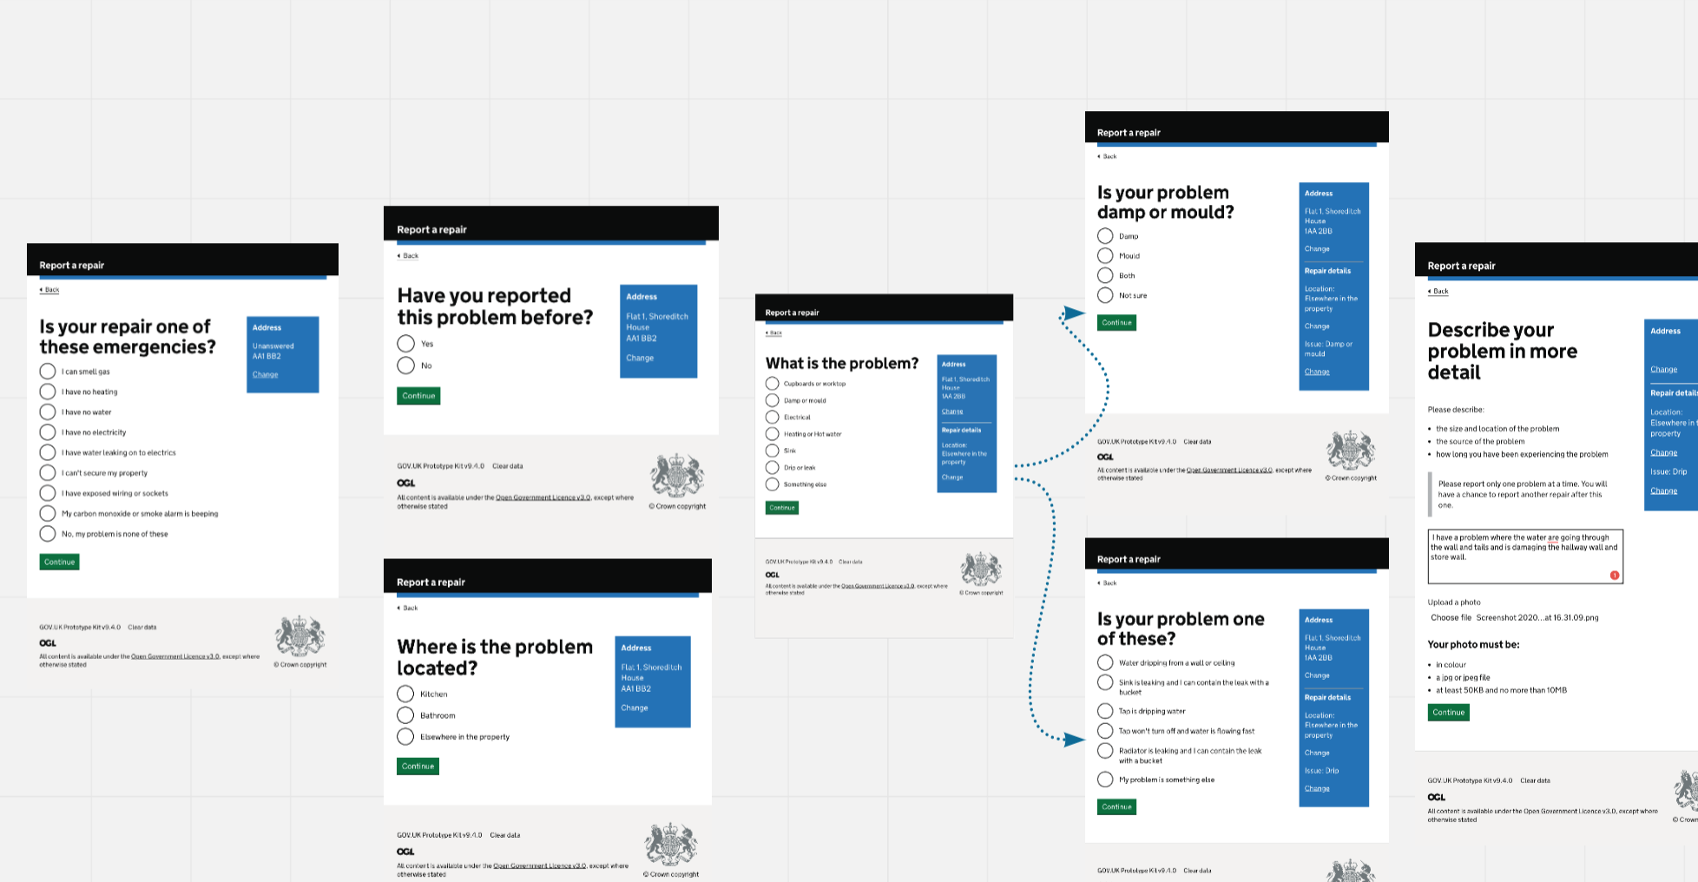
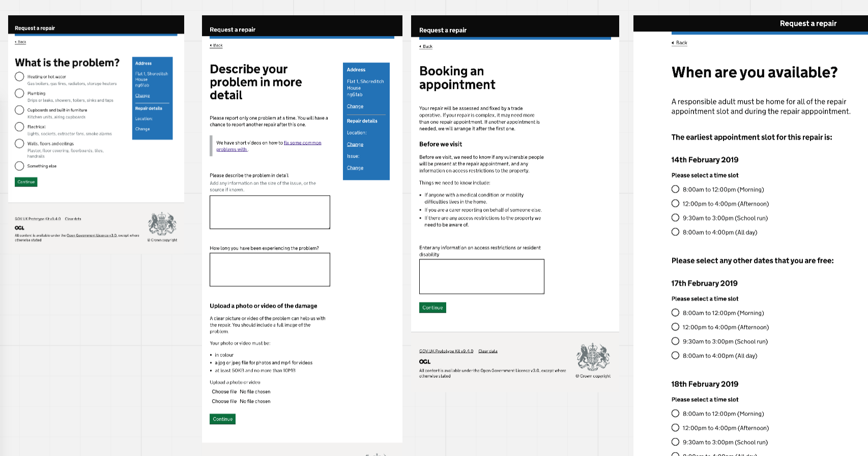
TWO ROUNDS OF TESTING
Round one
Elimination style journey including a list of emergencies
Multiple/more detailed steps to determine what the problem is
Round two
Separated ‘check before you start’ eligibility (not tested)
Simplified/shortened category and keyword-based problem selection. And revised problem description page
Ability to book an appointment
Confirmation template (tested)

Slide 11
What we learned

Slide 12
ALPHA LIMITATIONS
Research and design limitations
The development of this alpha service pattern was limited by the following factors :
The second round of research didn’t test a version of ‘check before you start’ to get a better understanding on how to handle eligibility in a way that’s useful for councils and intuitive for residents
We did not focus our research on leaseholders
We did not explore communal repairs
We focused the project on leak-type repairs rather than exploring other types of repairs
Our research participants did not include many younger and less experienced residents, or any males
We didn’t speak to anyone who would report a repair on someone else’s behalf
We did not get to speak to very many planners/schedulers or operatives
We did not explore authentication or “my account” journeys of reporting repairs

Slide 13
Commonalities
Housing repair services in local authorities are driven by a consistent set of needs and requirements and at a high level the journey for the resident is consistent across the four authorities.
The drivers for change (cost, time, user satisfaction) are also consistent with a fairly standard set of pain points driving failure demand.
Reporting and booking a housing repair is well suited for a common service pattern for authorities to anchor their services around.
User and organisational needs
Statutory requirements
Drivers for change
Pain points
High level user journey
High level system flow

Slide 14
Differences
There are differences in how different local authorities manage and operate the housing repairs service, and some differences in the local contexts.
These differences may constrain the adoption of a complete service pattern (for example technical integration) by an authority, but a modular pattern will allow authorities to adopt parts of a pattern.
The common service pattern should therefore be a ‘suite of patterns’ that can hang and fit together to form the whole journey, but that don’t require an authority to use all of the parts if they are not able to.
Existing technology products
Resident responsibilities (eg TMOs)
Number and type of operatives
Local context (eg number of leaseholders)
Existing processes and contact points

Slide 15
LONG TERM CHALLENGE
Rebuilding trust in the service will remain the biggest challenge for councils. Collectively adopting and iterating user-centred service patterns, designing for whole problems together with the GOV.UK design system will enable councils to achieve this.

Slide 16
NO TRUST IN THE SERVICE - WHY
You go online, fill out the form to report the problem, then nothing.
Residents don’t trust online reporting and the repairs service as a whole because their experience so far is disjointed. Even if residents can access and use an online service it doesn’t necessarily mean they will.
I'm hoping they'd ring me up as soon as possible but there's no guarantee on that. And you'd have to do it all again if they didn't

Slide 17
NO TRUST IN THE SERVICE - WHY
Sometimes we hear from people I’ve sent an email and you’ve ignored it. And we haven’t, we forwarded it on.
~call centre agent
Online enquiries are unintentionally de-prioritised and can get lost.
Agents receive requests from residents, their representatives and other teams like mobile care takers. They handle emails, online enquiries and paper forms in-between calls. There’s no effective way to track all these enquiries, especially once a job is raised or forwarded to another team or organisation.

Slide 18
NO TRUST IN THE SERVICE - WHY
If we’ve been out and it’s been completed before, it’s a brand new repair. If they were out-carded, we book it as a brand new repair. If bad job was done the first time around, it’s a brand new repair.
~ call centre agent
‘New’ and ‘completed’ repairs mean different things to councils and residents.
Tenants’ needs are fulfilled only when all jobs are complete to an acceptable standard. They also expect council to identify and prioritise recurring and more complex problems, and ensure overall continuity. Councils work mainly from job-to-job and don’t have the visibility they need to track and check the quality of end-to-end repairs. Together this makes it difficult for councils to provide good service and keep costs low.

Slide 19
NO TRUST IN THE SERVICE - WHY
Residents often feel misunderstood and blame agents’ lack of experience. Councils should adopt common standards for handling repair enquiries beyond online patterns.
We can’t diagnose over the phone, just raise the jobs. Generally, about repairs, I don’t have that much knowledge.
~ call centre agents (composite quote)
We couldn't make [the agent] understand it was inside. They've got young people training [who] don't understand the problems.
~ long-term council tenant
Agents often don’t have the technical knowledge, tools or time to diagnose repairs properly, so they do what they can and move on. It is also accepted that handling repairs effectively needs “personal or expert knowledge”. In reality, this is a symptom of institutionalised information and siloed processes. Agents should have access to standardised guidance like call scripts with user-friendly diagnosis questions, easily-accessible information about properties and repositories of common problems and causes.

Slide 20
RECOMMENDATION - APPLY SERVICE DESIGN
An online reporting tool needs to work seamlessly with the rest of the service instead of being an add-on. To drive digital uptake councils will also need to: improve and standardise ways of working communicate the improvements and benefits to residents linking back to their needs and using their language provide assisted digital via libraries or walk-in centres so that residents with access and skill barriers can also use online-first services

